Slide 1
Culture
Chapter 4 – Folk and Popular Culture
Chapter 5 – Language
Chapter 6 – Religion
Chapter 7 – Ethnicity
Cultural Geography:
A subfield of Geography
focuses upon the patterns and interactions of human culture, both material and non-material.
*Carl Sauer. Argued that cultural landscapes should be the focus of human geography.

Slide 2
Unit Objectives
Artifact. = Any item, made by humans, that represents a material aspect of culture.
Identifying and analyzing culture, cultural traits, diffusion, acculturation, assimilation, and cultural regions.
Identifying and explaining various cultural landscapes and understanding a sense of place
Understanding how cultural patterns are represented at various scales from local to global.
Understanding the origin and distribution of languages
Identifying Universalizing and Ethnic Religions and recognizing how religions organize space
Understanding the distribution of ethnicities, why some have become nationalities and some current and historical ethnic conflicts.
Describing and explaining differences and similarities between world languages, world religions, ethnic groups (ethnicity), and popular/ folk culture.
Customs = the frequent repetition of an act, to the extent that it becomes characteristic of the group of people performing the act.
Example: Americans eating turkey on thanksgiving
Tradition = A cohesive collection of customs within a cultural group

Slide 3
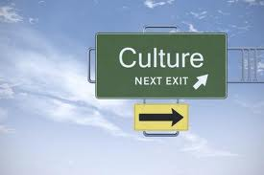
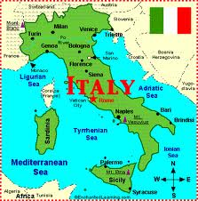
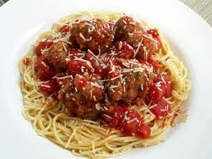
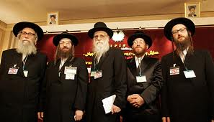
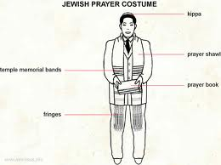
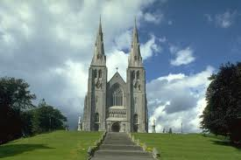
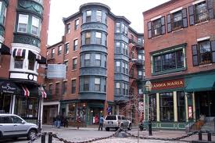
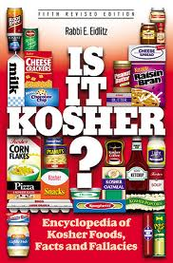
What is Culture?
Sum of all the typical activities of a group of people
Cultural Traits: Values, Material items, Political institutions, housing (architecture), religion, transportation, entertainment, art, technology
= Cultural Identity
Many traits are linked together and affect each other
Ethnic Group Food Religion Values
Religion values Clothes Food

Slide 4
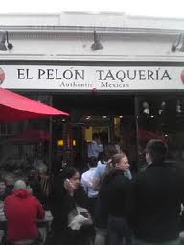
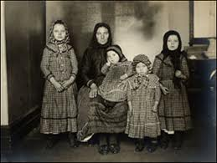
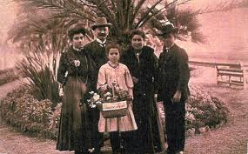
How does Culture Change
Examples:
Acculturation – the process of the less dominant culture adopting the traits of the more dominate one
Assimilation – when immigrants lose their native customs completely
Transculturation– two-way flow of culture, a merging and converging of cultures

Slide 5
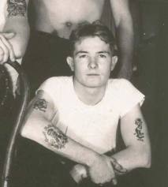
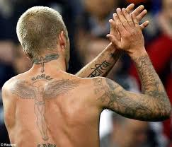
How does Culture Change
Examples:
Innovation – new creation/ new ideas that a culture accepts
Diffusion – when an idea or innovation spread from one person or a group to another and is adopted
(remember all the different ways this can spread)

Slide 6
How do we interpret culture
Ethnocentrism:
The practice of judging another culture by the standards of one’s own culture
Cultural Relativism:
The practice of evaluating a culture by its own standards
http://www.cc.com/video-clips/xer89g/the-daily-show-with-jon-stewart-jason-jones--behind-the-veil---ayatollah-you-so

Slide 7
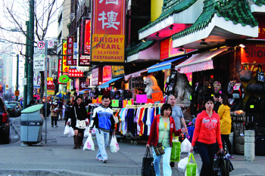
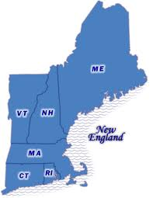
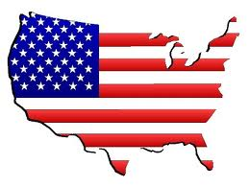
Groupings
Cultural systems – a group of interconnected culture complexes – an area with strong cultural ties that bind people together
Cultural Region – an area marked by culture that distinguishes itself from other regions
Cultural Realm – a large area marked by a number of cultural regions – it is set apart from other world areas b/c of these regions
Ethnic Enclaves:
An area w/ high ethnic concentrations, characteristic cultural identity & Economic Activity

Slide 8
Habit vs. Custom
Geographers study how culture influences behavior.
Difference between habit and custom
Habit is a repetitive act performed by an individual.
One college student wears jeans with colorful patches.
Custom is a repetitive act performed by a group.
All college students from the American South wear jeans with colorful patches.
Habit
Custom

Slide 9
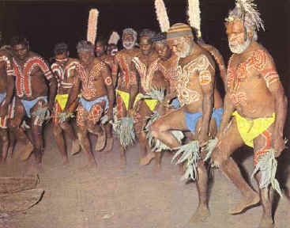
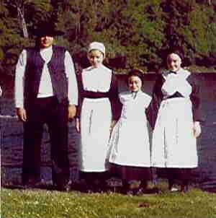
4.1.1: Compare the origin, diffusion, and distribution of folk and popular culture.
Pop VS
Folk
Popular Culture:
The practice of customs that span several different cultures and may even have a global focus
Large groups of people
Heterogeneous groups
Changes quickly
Dispersed – Global scale
Ex. Wearing jeans, eating fast food, attending sporting events
Hierarchical Diffusion through major centers i.e. NYC, LA, Chicago, London
Folk Culture:
The practice of relatively small group of people in a focused area
Small, isolated groups
Homogeneous groups
Slow to change
Clustered – local scale
Little interaction w/ others
Ex. Wearing a sari, driving a horse and buggy
Relocation Diffusion Ex: Amish people from PA. to KY.

Slide 10
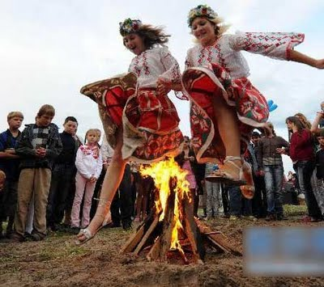
Diffusion of Pop and Folk Culture
Folk Culture is Clustered
Folk Culture
Isolation
Tends to lead to cultural diversity
Keeps folk cultures from changing much
Anonymous Hearths, sources, dates
Small Homogenous groups
Dependent on Physical Environment
Limits some choices
Example: Food habits strongly connected to environment
Belarus people celebrating a festival
REMEMBER POSSIBILISM
Some cultures in similar environments have different cultural traits
Some cultures in different environments have similar cultural traits (pop culture)
Some examples of these…

Slide 11
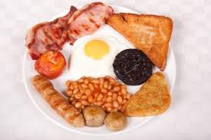
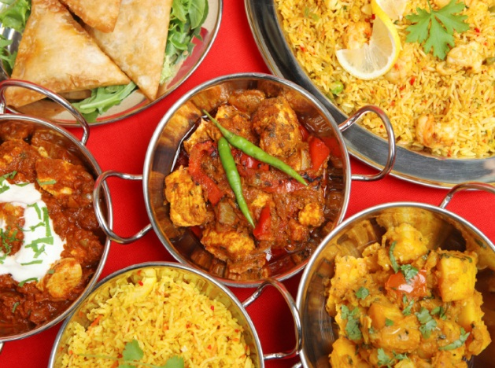
Diffusion of Folk Culture
Folk Culture Examples
Food customs (repetitive act of a group is a custom) strongly connected to environment
Attractions
Slow cook foods = N. Europe
Spicy food = 25˚ around equator
Taboos
Religious food taboos (often environmental reasons)
Taking on the phone in the bathroom
Different housing styles: combo of social customs & environment
How does physical geography impact local food styles/ regional dishes?
How does physical geography impact housing styles?

Slide 12
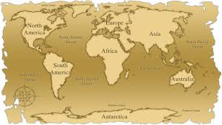
Worldwide Food Comparison
English meat pies
& soups
Spice Indian curries

Slide 13
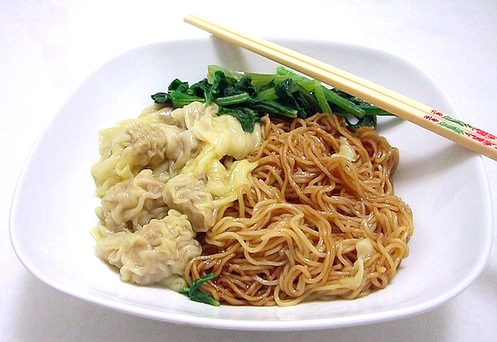
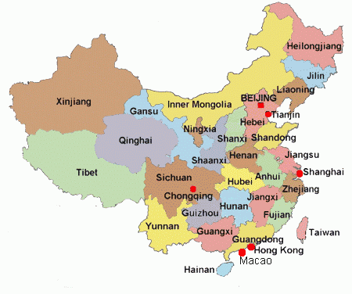
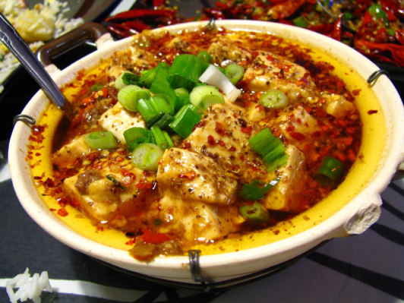
Regional Variations in China
regions renowned for their hot climates such as Sichuan and Hunan are also well known for their hot, spicy dishes
Northern China, on the other hand, is known for its noodles, since the primary agricultural product of this region is wheat.

Slide 14
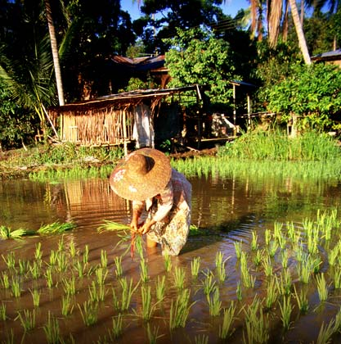
Chinese Food – Dependent on the Physical Environment
The available meat is largely pork, and chicken which can be raised on very little space.
It does not make economic sense to use valuable farmland as grassland for raising beef.
The lack of pasture land for grazing means that there are less milk and dairy products in the Chinese diet. Therefore, they use the soy bean to provide protein and calcium.
(adapting to the physical environment)

Slide 15
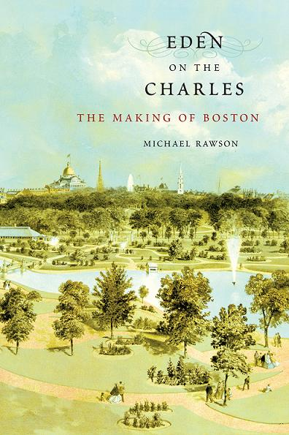
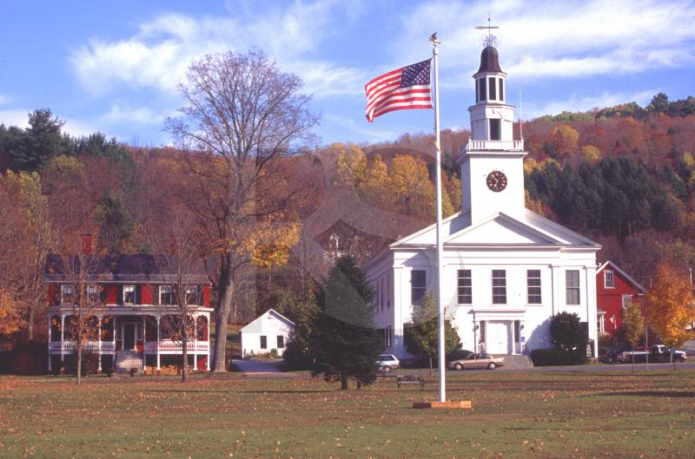
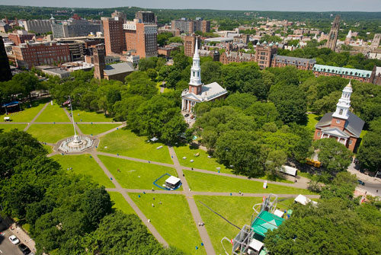
Religion and City/Town Planning
New England commons/ greens originally were designed around religious buildings
These areas have become public parks/ spaces
New Haven Green

Slide 16
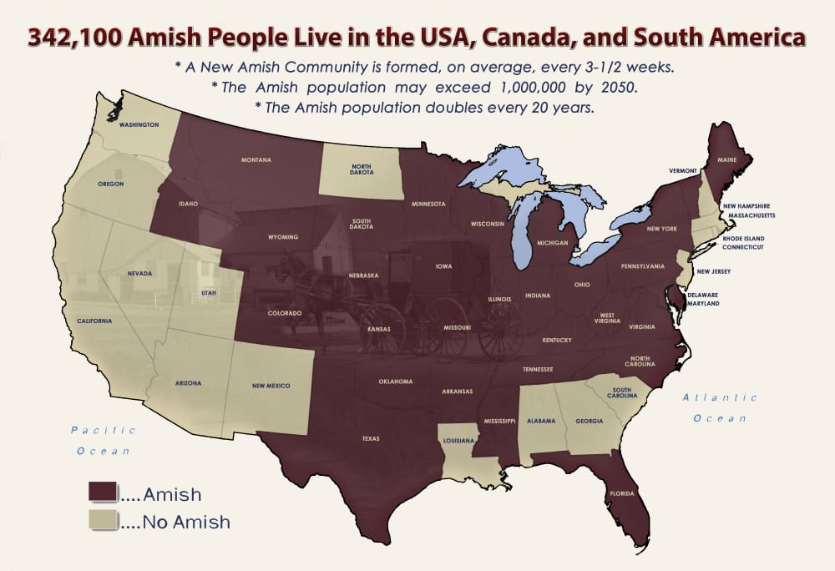

Slide 17
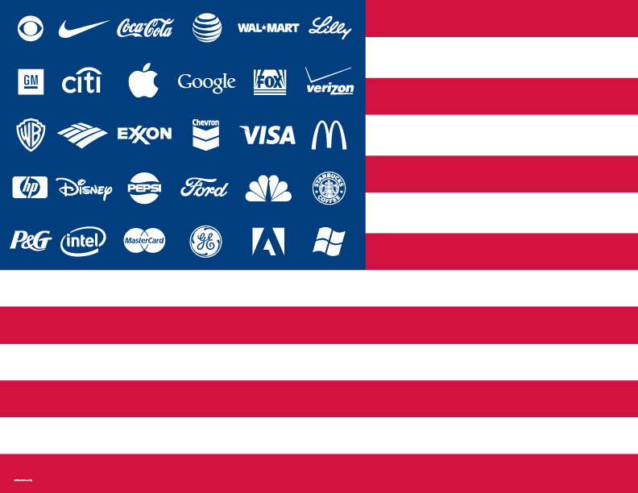
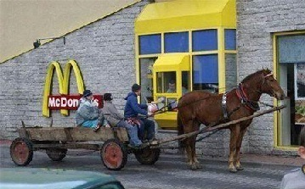
Pop Culture
Large, heterogeneous societies that share certain habits
Often the product of economically more developed countries
Largely urban based
Often allowed b/c of industrialization
Based on rapid & simultaneous global connections

Slide 18
Why is Popular Culture Widely Dispersed?
Communication Technology
Travel Technology
Globalization
The process of increased interconnectedness among countries most notably in their economics, politics and culture
Backlash = fundamentalism
Diffusion of Clothing
Dress = Status/Income
(Folk Culture: Dress = Cultural Group)
Clothing choices NOT environmentally driven
Diffusion of Housing
Housing b/co standard across cultures in MDCs
Cheaper to build
Built by professionals
Housing varies across time NOT space
Diffusion of Food
MDCs consume LOTS of snack foods & alcohol (higher standards of living)
Huge $$$ on advertising to encourage consumption

Slide 19
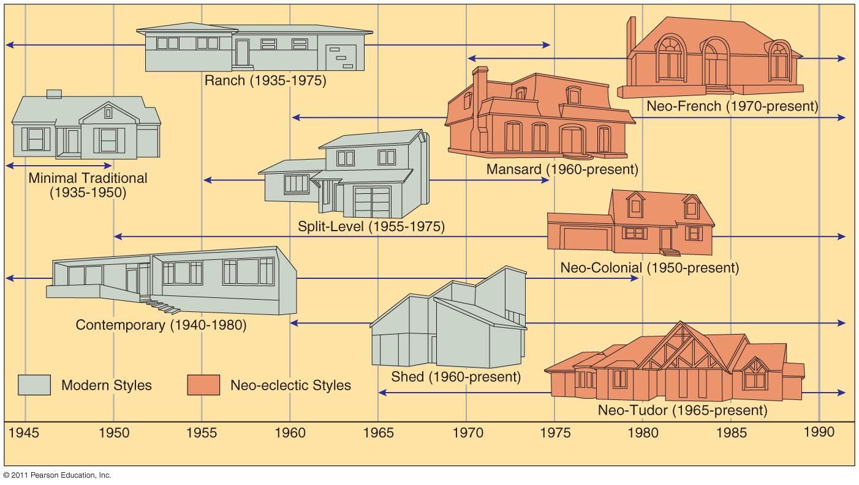
U.S. House Types (1945–1990)
Popular culture housing varies across TIME not SPACE
Modernized traditional dwelling
new materials and layout (ex: multi-bedroom, 2 car garage)
Modern dwelling
advanced technology reflected (ex: most common in US)

Slide 20
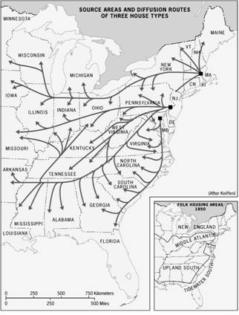
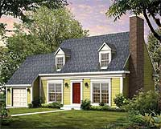
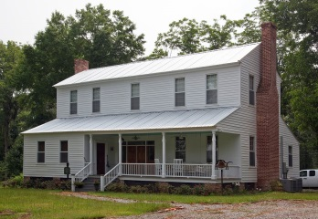
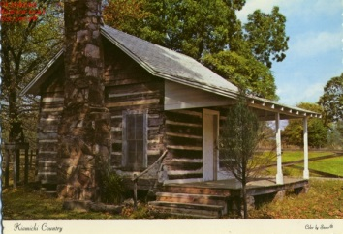
Folk Housing Styles
building styles that are particular to the culture of the people who have long inhabited the area; there are three distinct folk-housing regions in the United States
Reflect both cultural and environmental influences
Often based on available resources available (wood, brick, stone, grass & brush…)
Folk Architecture - Varies across SPACE | Nodes
Unchanged – traditional dwelling not altered by external influences ex: some Arab towns Modified traditional dwelling new materials, structure is same ex: change thatch roof to iron | New England: Salt Box Two Chimney Cape Cod Front Gable and Wing Middle Atlantic ‘I” Houses (originates as a one-room log cabin) Lower Chesapeake (southern) Steep Roof

Slide 21
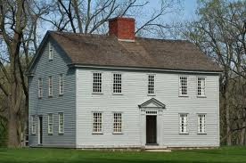
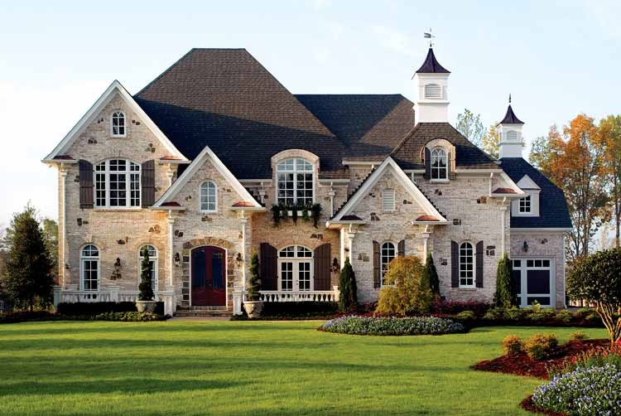
US Housing Conclusions
Older houses in the US display local folk cultural traditions
The style of pioneer homes reflected whatever upscale style was prevailing at the place on the East coast from which they migrated
Houses built in the US during the past half century display popular culture influences.

Slide 23
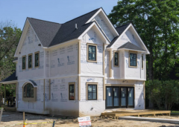
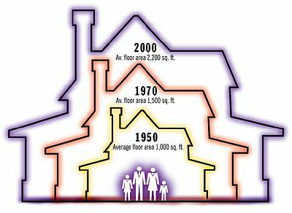
Pop Culture
Housing in popular culture is usually designed by professionals, not by the people who lives in the houses
Popular housing is not limited to locally available building materials
Popular housing styles vary more over time than regionally… for example, houses built in the 1950s tend to look alike, regardless of where they were built

Slide 24
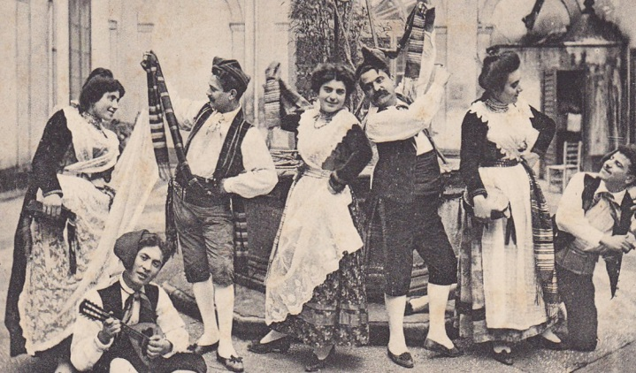
Where Do Folk Cultures Originate and Diffuse?
Origin of folk music
Folk music characteristics
Tells a story or recounts important life events or activities or customs
Contains important life cycle events (birth, death, marriage) customs
Is personal in nature –
you can learn a lot about a culture from their music

Slide 25
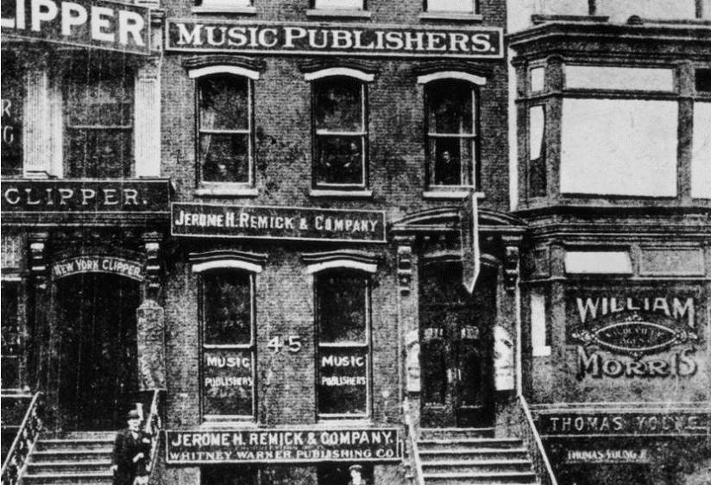
Where Do Cultures Originate and Diffuse?
Popular music characteristics
Originated around 1900 (tin pan alley)
Written by individuals for the purpose of selling to a large audience
Diffusion began in WW1
Highly technical
http://poly-graph.co/labels/
http://education.nationalgeographic.com/news/filipino-hip-hop/

Slide 26
Problems Associated w/ Globalization of Popular Culture
Threatens Folk Culture
Muslims view Western dress as a threat
Males lose power over females
Problems of looking “Westernized”
Effect on religious taboos and habits
Less people observe food/clothing restrictions
Negative popular culture transfers (pg. 137)
Increase in prostitution in LDCs
Blood Diamonds (Conflict Diamonds) in Africa
MDCs dominate the media
Over-represents Western ideas
Focus on negative aspects of LDCs(natural disasters)
Creation of a Uniform Landscape

Slide 27
Problems Cont.
Impact on the Environment
Uniform landscapes = most suburban areas VERY similar (strip malls & housing developments)
Depletion of natural resources
Golf courses use up a lot of land (& water)
Over-killing of animals for products/ sport (Africa)
Eating meat instead of grains – inefficient and expensive; is this suitable for LDCs??
Pollution
MDCs create MUCH more waste than LDCs (where folk culture is more prevalent)
(Keep in mind folk cultures also produce waste)

Slide 28
Religion and City/Town Planning
New England commons/ greens originally were designed around religious buildings
These areas have become public parks/ spaces
New Haven Green

