Slide 1
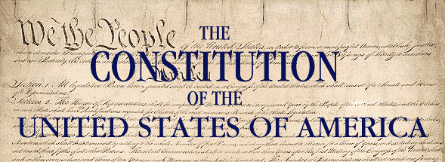
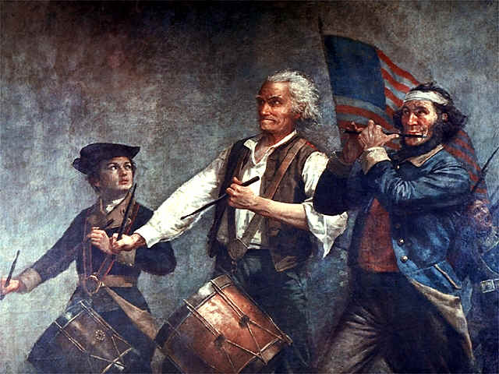
History and Civics

Slide 2
Agenda
Historical Overview
Outline and Two column Notes
How to complete homework assignments
Causes of the American Revolution
Two Viewpoints on the Battle of Lexington and Concord

Slide 3
Homework Notes
Option 1: Take notes in an outline format.
I. Outline format Notes A. Make sure to put chapter and page number of section. B. Please be sure to include all section titles in blue, read and black and fill in main ideas. C. Events and details that relate to that section. Underline all vocabulary words in your notes. i. These notes should be complete, but do not copy complete sentences out of the book. You should be able to refer to your notes in order to answer the focus questions.
Option 2: Take Two-Column Notes
Two column notes separate the main ideas of a reading from supporting details or explanations. The act of separating the main ideas from the details strengthens the understanding and memory of the content are. This method requires active reading, and processing for the notes to be taken
Main Idea | Supporting Detail
Two – Column Note-taking | Separating main idea and details Strengths understanding and memory Requires active reading Processing of information must occur

Slide 4
The British Colonies – Comparing Regional Cultures
Main Idea | Supporting Detail
Regional Economic Patterns - variation in geography & climate create differing economic patterns | New England: Small farms for local use based on cold weather & short growing season $ from exported lumber and fish/ Large seaports for trade The Middle Colonies: More prosperous farms, primarily farming wheat Philadelphia & New York seaports grew from wheat trade The South: Large & Profitable farms of cash crops, (tobacco, rice & indigo)
Regional Social Patterns - Availability of education & patterns of settlement create differing social patterns | New England: Middle class immigrants, many of whom immigrated as families with a close gender ratio creates a quick population increase Heathier environment with longer life expectancy Favored compact settlements with public schools = higher literacy rates & greater economic equality The Middle Colonies: Most ethnically and culturally diverse area, from all over Europe Religious tolerance and economic opportunities drew immigrants in The South: Most immigrants were poor, single men. Many were indentured servants In parts of the South states slaves made up the majority of the population Plantation culture produced spread out communities, illiteracy & large economic differences
2 Column Notes

Slide 6
Competition & Conflict - Outline
Wars of Empire
European competition and the Colonies
British and the French are the main rivalry & fought several wars
France benefits from alliance with many Native American tribes, forts along Ohio & Mississippi Rivers
Britain benefits from growing population, powerful navy
French and Indian War (aka 7 years war)
War for control over north America, starts badly for the British but shifts when Britain uses navy to cut off French Supplies
Britain drives the French from North America and continues to fight the French in other areas of the world
Treaty of Paris (1763) gives Britain all of the French land in N.A.
Aftermath of Competition
Britain wanted greater control over colonies after going into debt in French & Indian War
Parliament thought colonist should pay these costs
American colonists create a delegation to cooperate in the event of another conflict (Albany Plan of Union)

Slide 7
Your Turn to Practice - Homework
Task:
1. With your partner read Chapter 4, Section 1.
Pick a Notes format and create a notes page for your assigned section
On separate sheet of paper write what you and your partner think are the top 5 causes of the American Revolution
Reading Skills:
As you read the text, you should be able to
Understand and apply the key ideas, concepts, people and vocabulary.
Also, you should start to get comfortable with making additional connections to the material in class, and to your life.
When you read a section
Read the title of the section. This is a quick way to know right away what you will be reading.
Read the focus question: Have this in your mind as you read and mentally answer it as you go.
Read the objectives: They tell you exactly what you will learn.
After you read a section, before you move on, take less than 1 minute to ask yourself what was that about? Can you can answer the focus question?

Slide 8
Long-Term Causes of the American Revolution
Political Background
English Political Ideas Influence the Colonies
Magna Carta
Limited the Monarch’s right to Tax and guaranteed Due Process
Parliament
A bicameral (2 house) legislature with an elected lower house. Representatives have the power to tax the people
English Bill of Rights
Right to Habeaus Corpus (to be charge and brought to trial). No Cruel or unusual punishment
Differences between English & Colonial Gov’t
Salutary Neglect - British policy towards the colonizes that allowed colonies local self-rule in exchange for cooperation with economic policies and help fighting France and Spain in the Americas.
Colonies have Elected assemblies
Mercantilism – belief that European nations should maximize exports (to make $) and minimize imports (sell more than you buy)
Colonies are used as markets for European nations. Colonies can ONLY trade with their mother countries
England becomes very wealthy from this policy
French & Indian War (7 yrs war) effects
French vs. England for control of North America (England wins)
War puts England heavily into debt, they expect the colonist to help pay for the war

Slide 9
Revolution! Events in Succession
1764-Colonial Assemblies win the right to levy taxes.
1764-Parliament passes the Sugar Tax, an indirect tax.
1765-Colonists protest the Stamp Tax
(Quick side notes.....These taxes focused more on the wholesale distribution of these products. This impacted the merchants more than any other group. Regular colonists, who sometimes benefited from the taxes, were caught up in the fact that the taxes were being imposed without having a voice that represented them in Parliament.)
1767-Parliament passes the Townsend Acts,
which taxes a little bit of everything (glass, paper, tea, paint, lead).
1767-Violence erupts in Boston over the Townsend Acts.
The Liberty is taken by customs agents for smuggling. The ships owner. John Hancock, was not pleased. Riots are suppressed by an influx of British troops.
1770-Customs agents attacked by Boston colonists.
1770-Five "patriots" killed in the Boston Massacre.
1773-The "Sons of Liberty" organize the Boston Tea Party.
1774-Parliament passes the Intolerable Acts.
This shuts down the Massachusetts colonial assembly and imposes martial law in Boston.
1774- the First Continental Congress meets in Philadelphia.

Slide 10
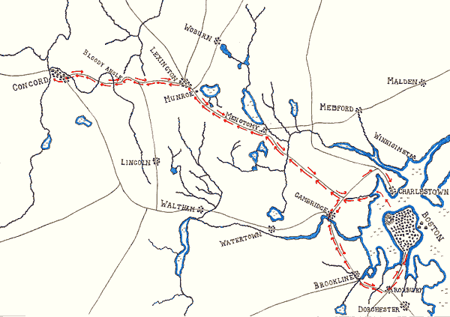
1775-War begins on the morning of April 19th

Slide 11
Conflicting Version of the Outbreak of The American Revolution (1775) Lexington and Concord
Colonists
British

Slide 12
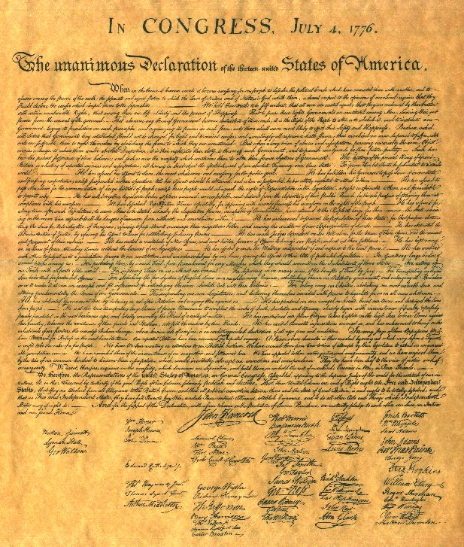
Timeline of Events
May 1775 – Second Continental Congress Meets
New Continental Army created and command given to George Washington
July 1775 Congress send “Olive Branch Petition” to King George III
Petition is rejected
January 1776 Common Sense by Thomas Paine is published
Proposed independence, republican state go’vt and a union of states
July 2nd 1776 Congress votes that America is free
July 4th 1776 Approve the Declaration of Independence
Based on Enlightenment ideas that all men have natural (unalienable rights)

Slide 13
Should the Colonists declare Independence?
As you listen to the Clips record the arguments of each speaker
Advantages
Disadvantages

Slide 14
Should the Colonists declare Independence?
Disadvantages
Advantages
Might cause division within the colonies
If Revolution failed, the and leaders might be tried and executed as traitors.
Might lose friends in England who supported cause of colonists in regard to representation in Parliament but not independence
Colonies were poorly prepared for war Fighting the largest military power in the world No weapons nor manufacturing to make them
Colonists would be cutting themselves off from the biggest, freest empire in the world.
Sentimental attachment to homeland
Stating for the world the ideological basis of this new country
Freedom from subservience to the King
Independence might unite different areas of the colonies
Possibility of foreign aid from France
Legitimacy in the world community
Captured soldiers treated as POWs not spies or rebels

Slide 15
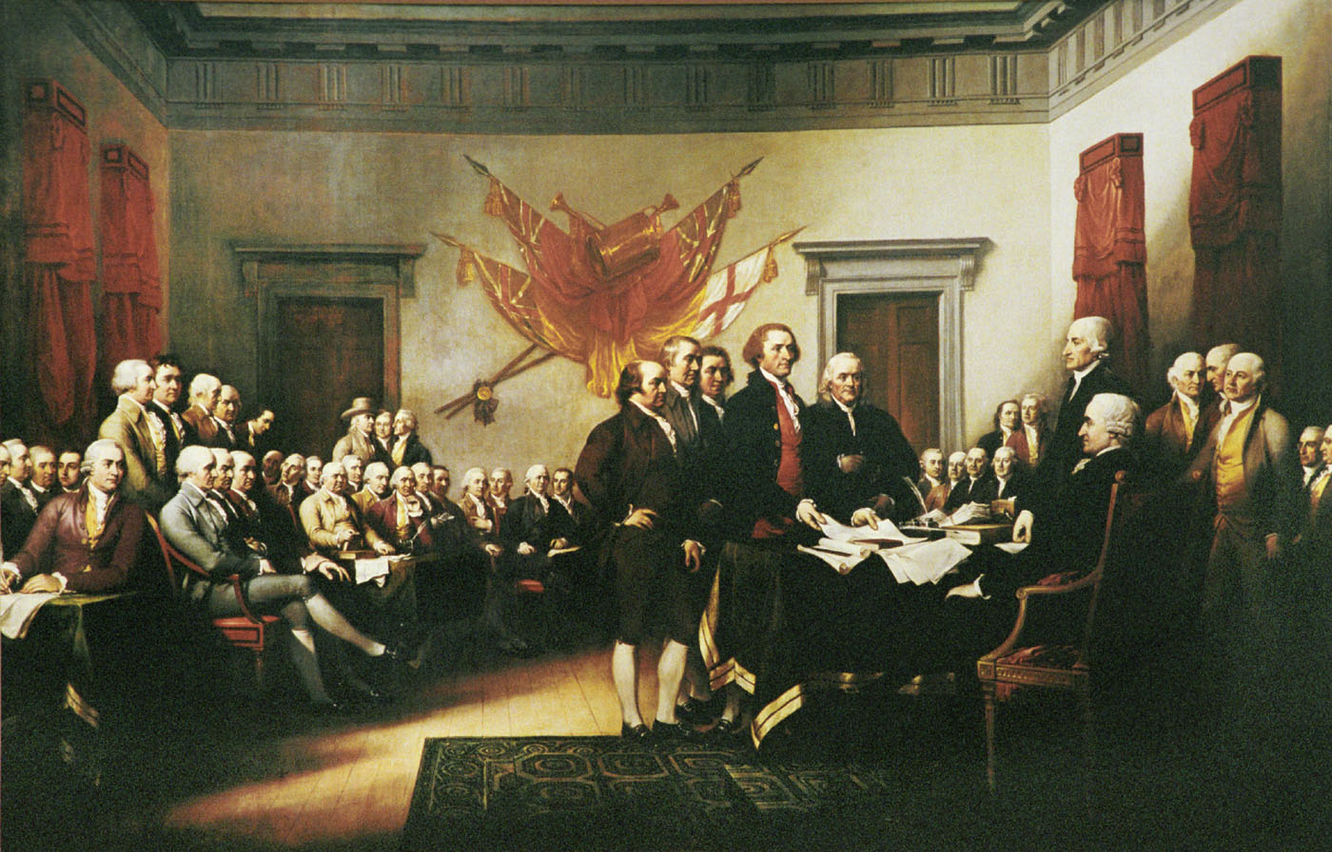
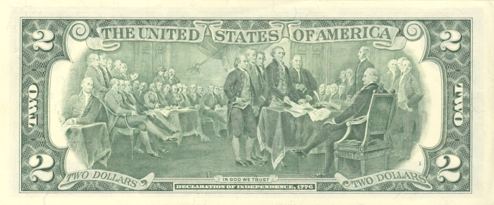
North Carolina: William Hooper Joseph Hewes John Penn
Notes:
shows the five-man drafting committee presenting their draft of the Declaration to the Congress, an event that took place on June 28, 1776

Slide 16
Viewpoints on the Revolution
 | African Americans | American Loyalists | American Patriots | Native Americans | Women
general motivation
specific call to action
attitudes about rights
claim of authority
Role(s)

Slide 17
Viewpoints on the Revolution
 | African Americans | American Loyalists | American Patriots | Native Americans | Women
general motivation | Memoir on participation in the war *freedom | Writing in Response to Common Sense Doc. | Battles of Lexington & Concord (Army is needed) | Responding to Patriot request to join the war | Diary Entry (participating in conflict)
specific call to action | Describes Joining the British Army & gaining his Freedom | Rejoin Great Britain, end the war | Join the Patriot Army | Peace between ‘brothers’ (reconcile with GB) | Supports husband in fight against British
attitudes about rights | Importance of Freedom | No gaining of new rights, rejoin GB for stability & economy | Fighting for natural rights | Assume right to neutrality | None (women gain more responsibilities during the war, but no rights)
claim of authority | Moral argument | Common sense, morality & emotional | Moral argument | Moral argument | None (demonstrates the role of women)
Role(s) | Soldier/ autobiography | writer | Governmental body | Eventual joins patriots | Runs household in husbands absence

Slide 18
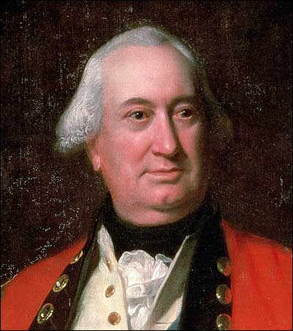
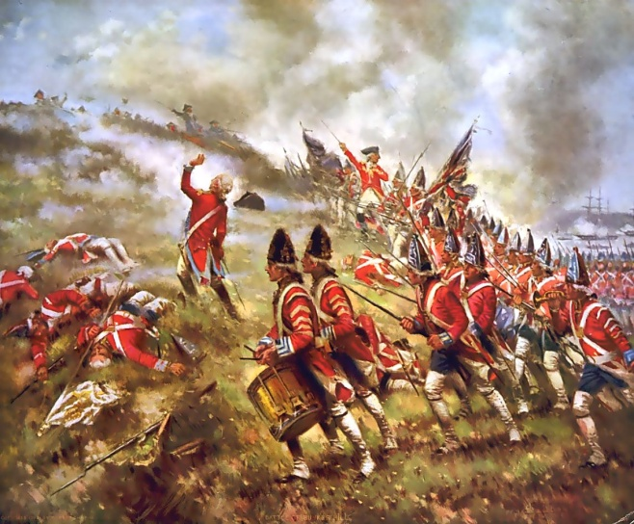
Strengths and Weaknesses of the British Army
Weaknesses
Strengths
Hubris
Did not take the colonists seriously
Misunderstood the nature of the conflict
Wanted to fight a traditional war
World Power
Population over 4 times the size of the colonies
Leader in Manufacturing
Established Central Government
Well trained troops with plenty of supplies

Slide 19
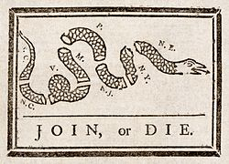
Strengths and Weaknesses of the Patriot Army
Strengths
Weaknesses
Persistence
Skillful retreats saved the army
Used Guerilla warfare and unorthodox tactics
Worked with local militias understanding of the local terrain
Received aid and support from civilian population
At least 1/5 of population were loyalists and another 1/5 were slaves (many of whom supported the British)
The American people were starting from scratch. No central government
Continental congress struggled to pay for the war
Paper money caused inflation
Soldiers suffered from hunger and cold
Troops were outnumbered and often outmaneuvered

Slide 20
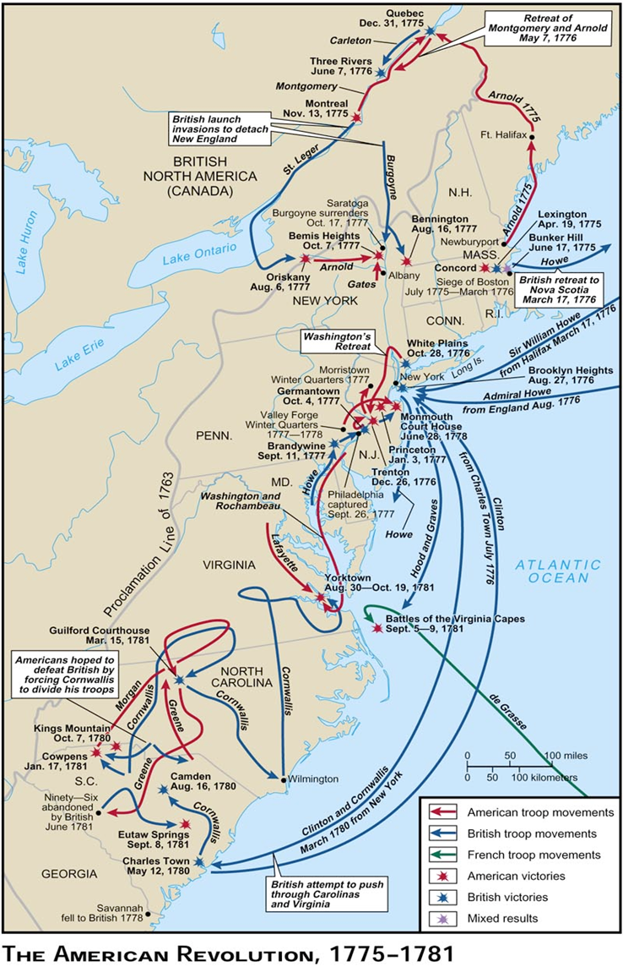
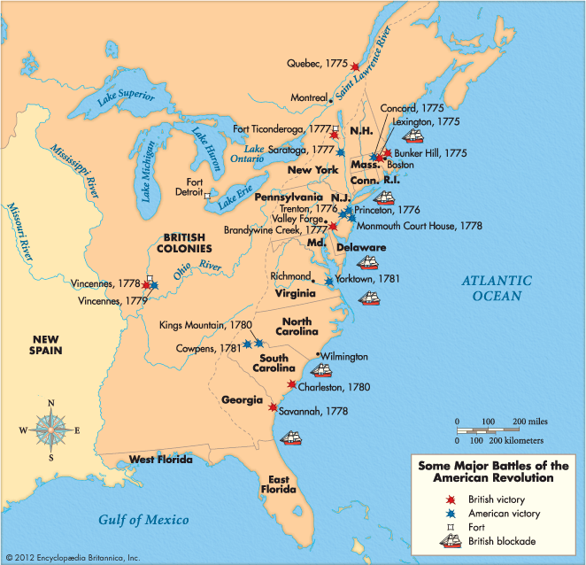
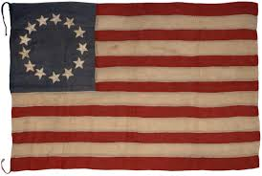
Turning Pts. Of the War
3. Battle of Saratoga
France Enter the War!!!
1. Battle of Trenton
Battle of Monmouth
2. Battle of Princeton
The British Move South
Realize they can’t win the North
Believe loyalists in the South with help them
Believe capturing southern cities will cause the colonists to surrender
Battle of Yorktown

Slide 21
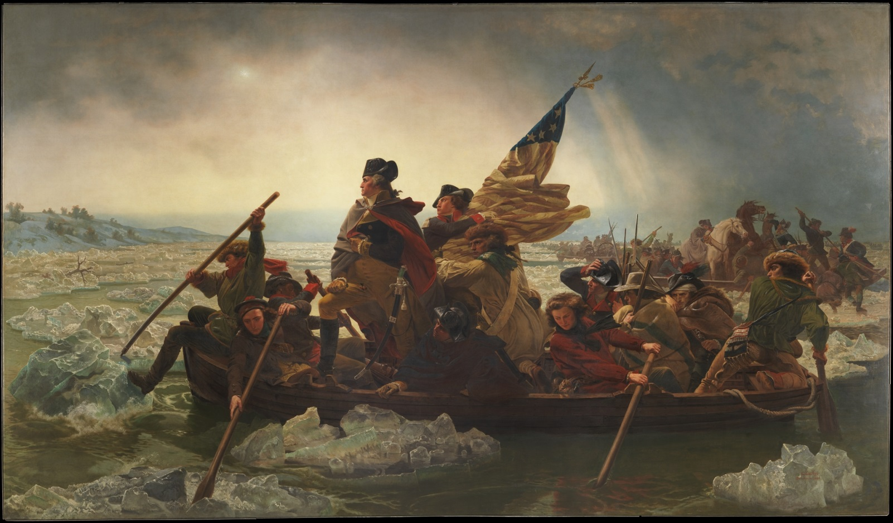
Turning Points of the American Revolution What factors helped the patriots win the war?
Patriot Victories
December 26, 1776 – The Battle of Trenton
January 1777 – Battle of Princeton
October 1777 – Battle of Saratoga
December 1777 – Valley Forge
February 1778 – The French enter the war as America’s ally (sending military aid)
June 1778 – Victory at the Battle of Monmouth
October 19th 1781 - Yorktown
Crossing of the Delaware River - modest victory
Yes, winning battles help win the war…
Washington vs. Cornwallis = British suffer large casualties
=
1783 Treaty of Paris signed recognizing American Independence and gave large territory to the new nation
Benedict Arnold Defeat s the British! Encouraged France to enter the war
Survive the Winter & improve as soldiers
Marquis de Lafayette + a NAVY!!!
American Soldiers demonstrate improved discipline
Washington traps Cornwallis with the help of the French Navy

Slide 22
Women
- Republican Mothers
- Few gains in rights or responsibilities
African Americans
- Slavery ends in the north
- South maintains slavery
United States
Native Americans
- Abandoned by the British
- Forced to give up land
Foreign Countries
- An example of Revolutionary Republicanism
- French Revolution
Effects of the Revolution

Slide 23
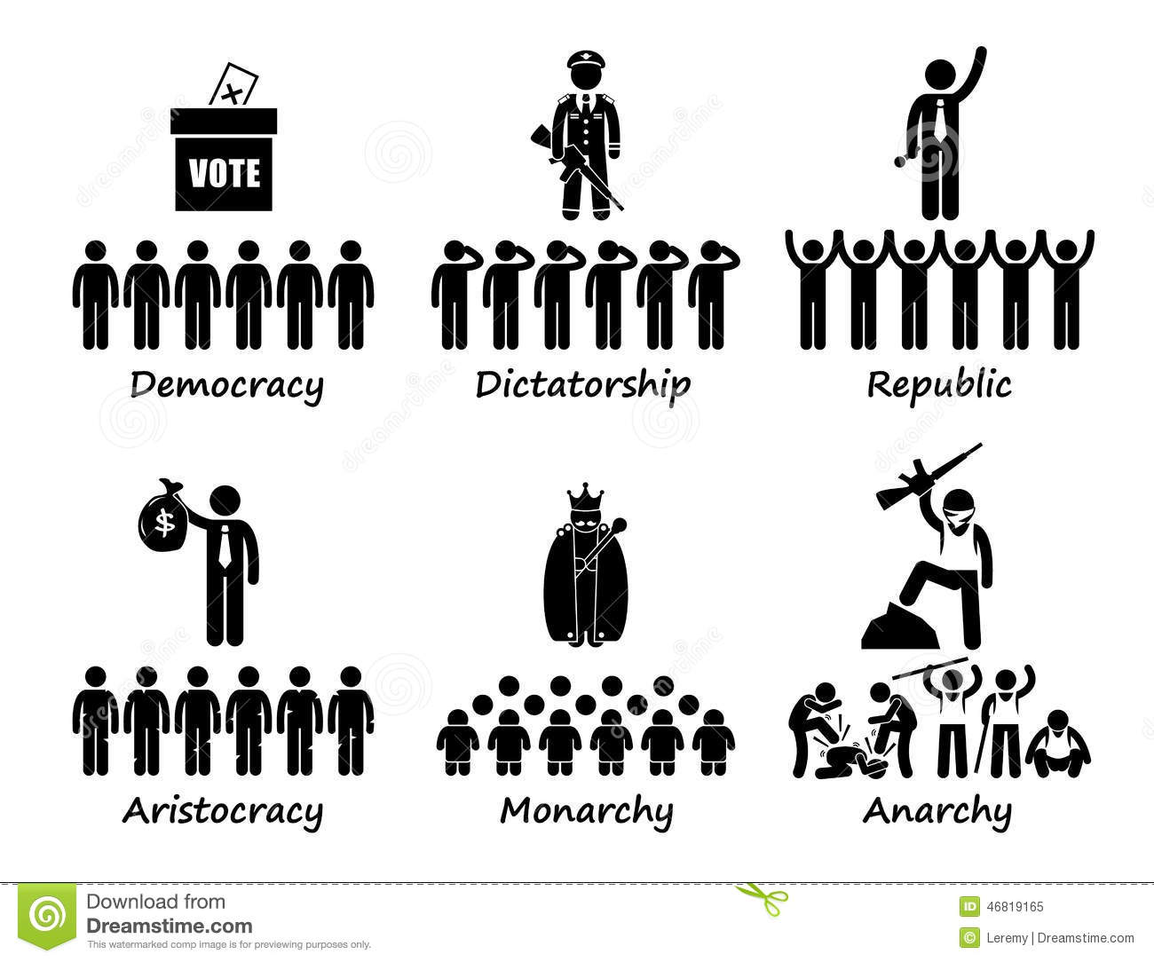
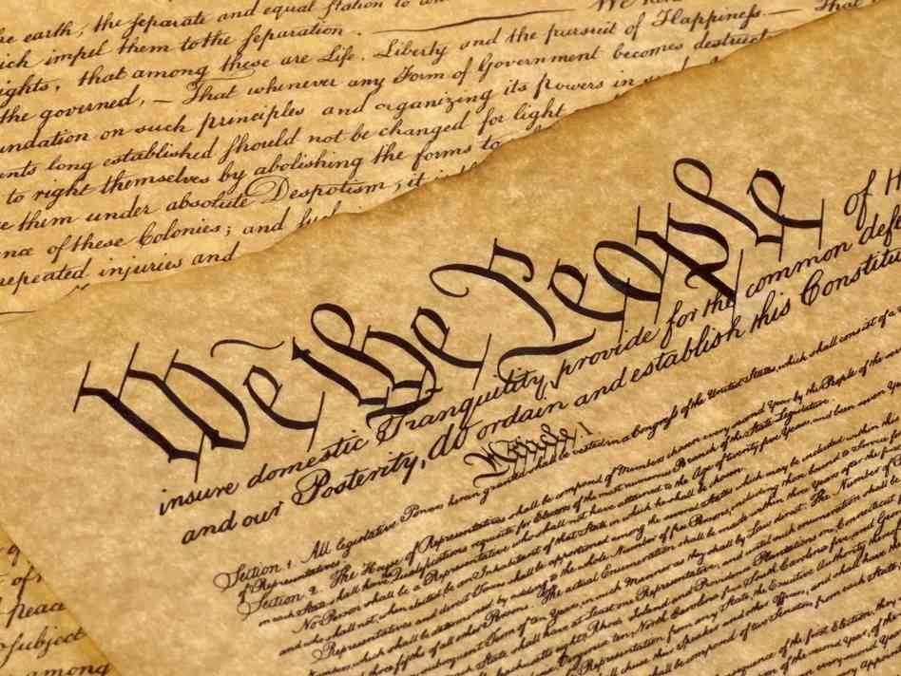
Creating a Constitution

Slide 24
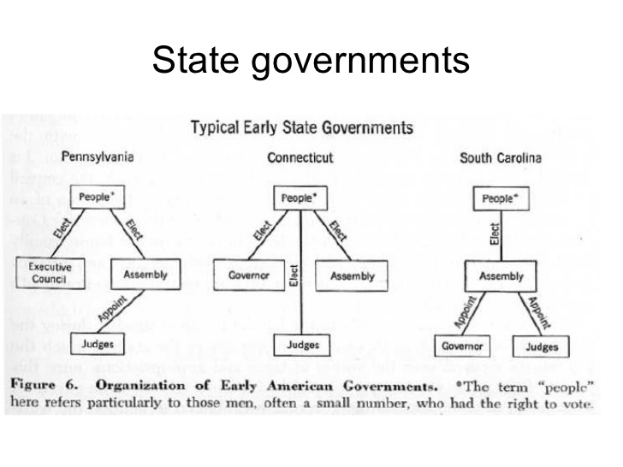
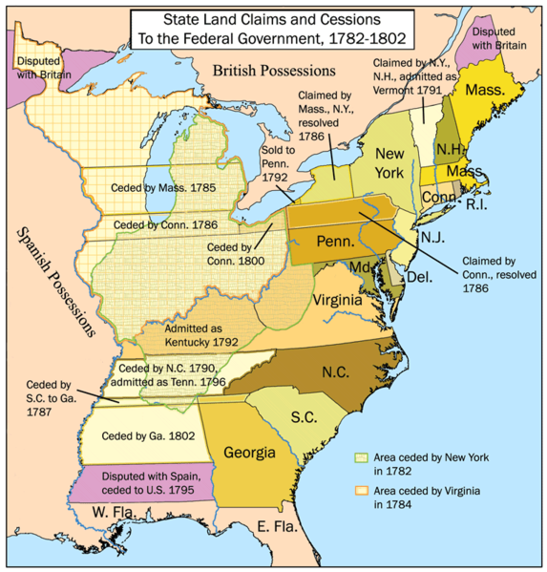
What form of national government did the Patriots create initially, and what events revealed that a new government was necessary?
Early State Governments
All states establish republics, in which voters choose representatives
Most states had a bicameral legislature
Most states required property ownership for the right to vote
Most states guaranteed religious freedom in their constitutions

Slide 25
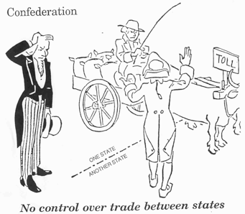
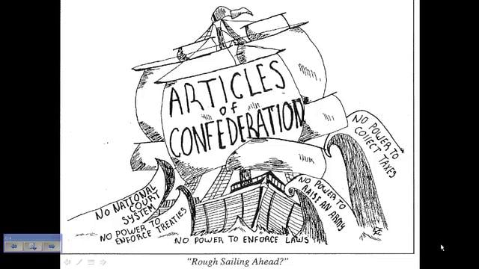
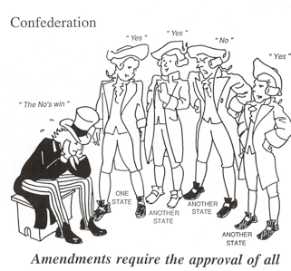
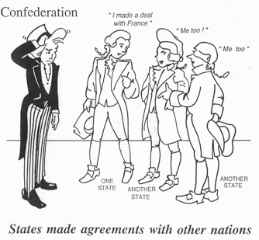
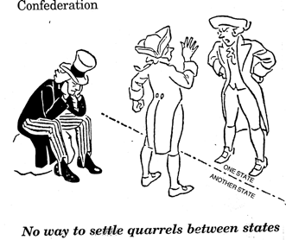
Article of Confederations 1783-1787 (Early National Government)
Loose confederation of states
Each state has one vote regardless of size
Why is a Legislature preferred? Legislature = Pluralism
No Executive Branch
No Judicial Branch
Congress unable to levy taxes, unable to pay nation’s debts
Unable to solve growing national problems or legitimize the nation internationally
Why did Americans choose this form of government at first?
Americans are worried about the creation of a strong central power. They do not want to return to a British system of government that would threaten the rights of individuals and the power of the states

Slide 26
Problems Arise
National Debt – the war and the States spending bankrupts the nation
Foreign Relations
The Spanish forbid American trade
Relations with the British deteriorate over the issues of trade and worries of British expansion
No national Army or Navy
Debt collectors enforce laws to extreme levels
Shays Rebellion – 1786 – 87
What was Shays’s Rebellion?
What impact did Shays’s Rebellion have? (how did people view the revolt?)
What was life like under the Articles of Confederation?
Outcome: Rebellion quelled through the use of force with an army raised in the east

Slide 27
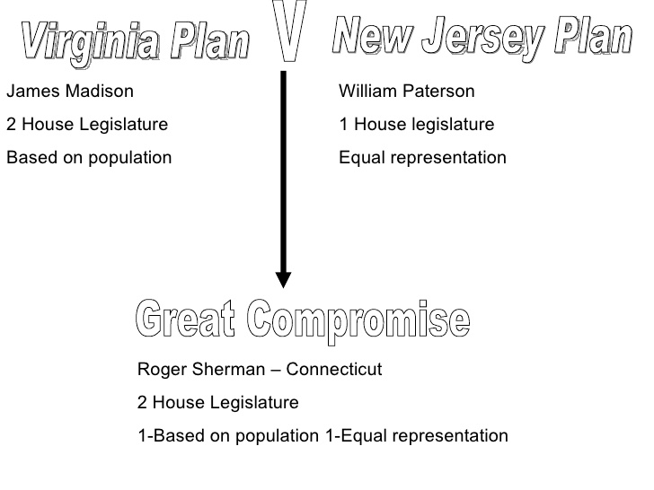
What new national government did the delegates agree upon at the constitutional Convention of 1787?
Proposals for a national government
Virginia Plan
- Bicameral Legislature
- 3 branches of gov’t
New Jersey Plan
- Unicameral legislature
- State sovereignty

Slide 28
Compromises
How do you determine a state’s population?
3/5 Compromise
Connecticut Compromise
Slaves counted as 3/5th of a person when taking census
Added to a states population
*most controversial element of the Constitution
Legitimized slavery as an institution that was ‘too big to fail’ in the south
Cuts off all discussion on ending slavery & set the stage for the Civil War
Creates a contradiction between the goals of the Revolution and real life in America (“all men created equal”)
Bicameral Legislature that addresses New Jersey Plan’s desire to maintain state sovereignty
Senate represents each state equally
House of Representatives represents population

Slide 29
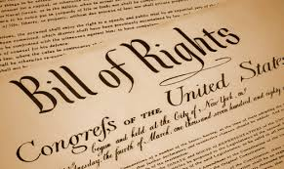
Constitutional Tour
Key Concepts
Activity 1: Tour the Constitution
Examine The Constitution on page 164 and fill out the following:
Requirements for office
Separation of Powers
Checks and Balances
Natural Born Citizen:
namely, someone who was a U.S. citizen at birth with no need to go through a naturalization proceeding at some later time.
intended to protect the nation from foreign influence.
Expressed Powers:
specifically listed in the Constitution.
Checks and Balances:
each branch of the government (executive, judicial, and legislative) has some measure of influence over the other branches and may choose to block procedures of the other branches.

Slide 30
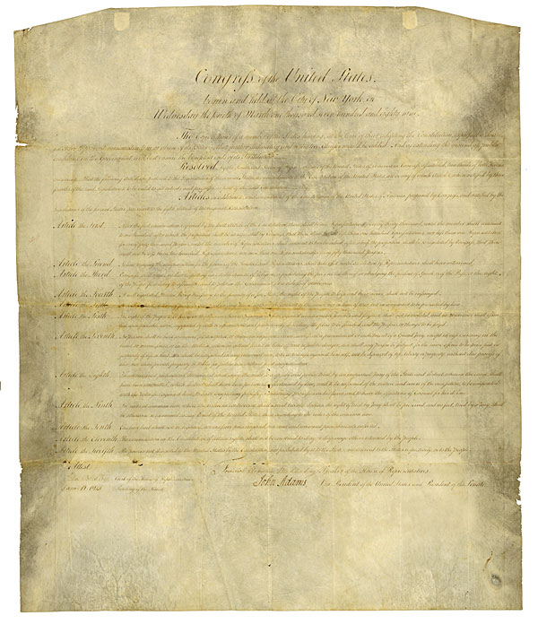
Bill of Rights
Activity 2:
Bill of Rights Background
Activity 3:
“Life without the Bill of Rights”
Examine the Bill of Rights and use this document to determine how these amendments apply to your everyday lives.
Read the background on the Bill of rights
Answer the questions on the given lined paper
Read the following story and identity violations of the amendments within the story.
Discuss the story with your partner.
Together Underline each offense, there are a total of 12.

Slide 31
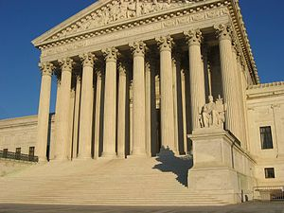
The Development of an Amendment
How have we (as a Nation) decided what the Amendments to the Constitution mean for citizens of the United States?
Gideon v. Wainwright
Judicial Review = the doctrine under which legislative and executive actions are subject to review (and possible invalidation) by the judiciary.
The United States Constitution does not explicitly establish the power of judicial review. Rather, the power has been inferred from the structure, provisions, and history of the Constitution.
Marbury v. Madison (1803),
the Supreme Court ruled that the federal courts have the duty to review the constitutionality of acts of Congress and to declare them void when they are contrary to the Constitution
A specific court with judicial review power must annul the acts of the state when it finds them incompatible with a higher authority

Slide 32
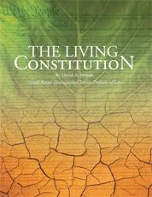
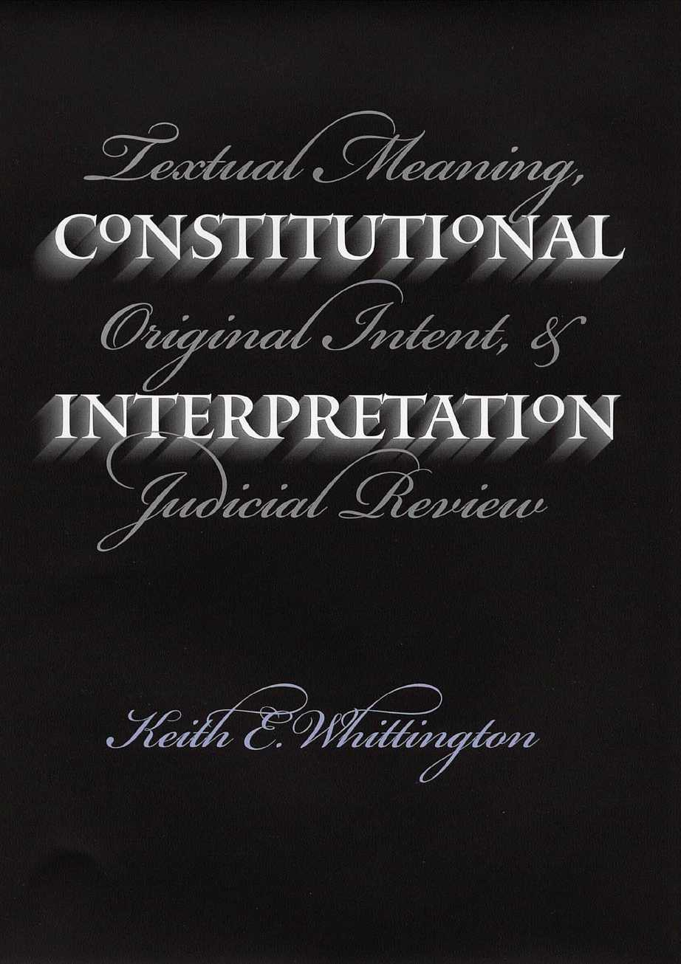
How should we view the Constitution?
‘Living Document’
Strict Interpretation

Slide 33
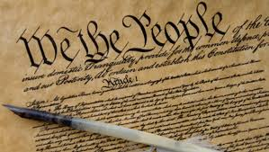
Ratification of the Constitution
Arguments in favor of the Constitution
Arguments against the Constitution

Slide 34
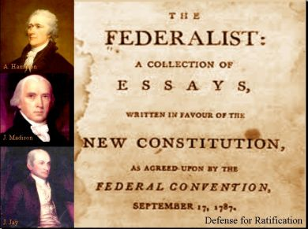
How did American ratify the Constitution and what were its basic principles?
Basic Principles
Limited Government
Republicanism
Checks and Balances
Federalism
Separation of Powers
Popular Sovereignty
Ratification
Federalists Vs. Anti-Federalists

Slide 35
How did American ratify the Constitution?
Remember….
The original purpose of the Constitutional Convention was to amend the Articles of Confederation
Once the delegates write & sign the Constitution in 1787 it is sent to the States for consideration
9 of the 13 states must Ratify before it goes into effect
The Ratification Process divides the Nation into:
Federalists
Anti- Federalists
Who were they?
Supported the Constitution
Led by Madison, Hamilton and John Jay
Who were they?
Opposed Constitution
Henry, Richard Henry Lee, George Mason and Samuel Adams

Slide 36
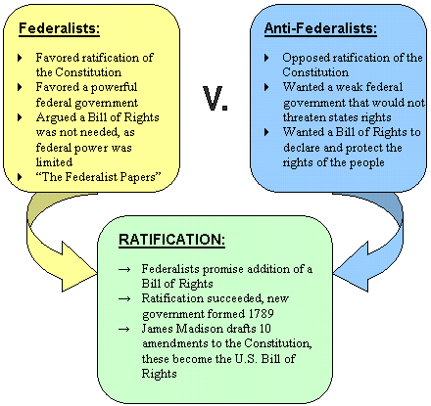
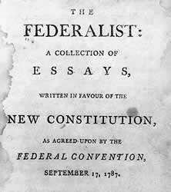
1. Argued that a strong central gov’t could overcome the difficulties facing the new nation
2. Checks and balances would prevent any of the branches from gaining too much power over the people
How did The Constitution get Ratified?

Slide 37
What are the 6 Big Ideas in the Constitution?
Rephrased in your own Words
Limited Government
Judicial Review
Checks and Balances
Federalism
Separation of Powers
Popular Sovereignty
→ “We the People” = the government is created by the people & can govern only with their consent

Slide 38
6 Big Ideas in the Constitution
The following are examples of each Big Idea. Identify what each part says & explain how this is an example of one of the Principles of the Constitution.
Article | Section | Clause
Article 1 | Sect 9 | Clause 2
Article 3 | Sect 2 | Clause 2
Article 1 | Sect 7 | Clause 2
Article 1 | Sect 10 | Clause 1
Article II | Sect 2 | Clause 2
The Preamble says “We the People…”
Limited Government
The government has only the powers the constitution provided
Judicial Review
Courts job is to interpret the Constitution and determine if law is valid or not
Checks and Balances
Each branch of government has the power to limit the actions of the other two
Federalism
The federal government and state governments share power
Separation of Powers
The government’s power is divided
Popular Sovereignty
The people are the source of the governments power
The gov’t can not suspend right of habeas corpus unless rebellion or invasion
“The judicial powers shall extend to… all cases… under the Constitution”
The President can veto a Bill… which can then be passed by Congress with 2/3rd majority
List of powers denied the states
Pres. & Congress must agree before a treaty goes into effect

Slide 39
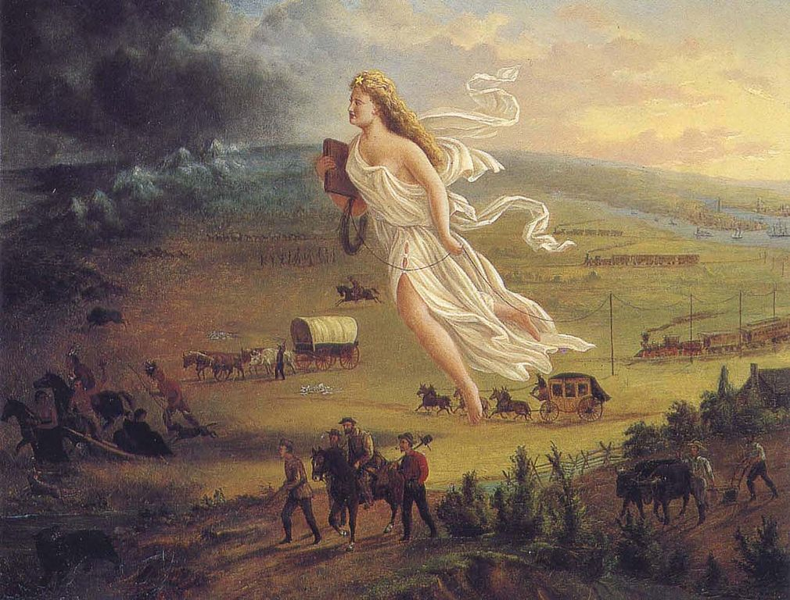
Expansion
How did American expansion reflect the development of an American identity and American nationalism?

Slide 40
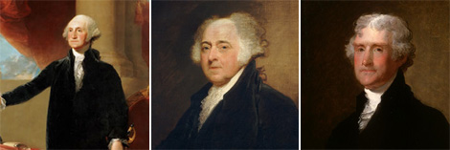
Expansion
Overview – Inventing a Nation
Washington, Adams, and Jefferson
The Nation Expands
Lewis and Clark
War of 1812
Age of Jackson
Trail of Tears
Nullification
Mexican American War
Justification
Impact
Wilmot Proviso
Sectionalism

Slide 41
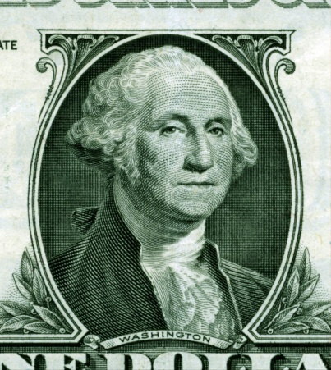
Inventing a Nation
I. Challenges Facing the New Nation
A). Problems that the new nation faced
1. High National Debt and increasing tensions with former foreign allies
- Example: At New Orleans, Spain closes the Mississippi River to
American Trade
II. Building the Federal Government
A. Electing Washington as President - 1789
1. Most trusted man the nation, united diverse opinions
B. Forming the Cabinet
1. Development of the Executive branch beyond the constitution. Advisors will establish the Executive as a more dynamic and creative position over time.
2. Secretary of state, Treasury, War, and the Attorney General.
C. Setting up the Judiciary
1. Ill-defined branch. Role of the courts grows and expands following the Judiciary Act of 1789. Supreme Court's key decisions and creation of precedent established the Judicial branches’ role in the federal government.

Slide 42
III. Paying off the National Debt
A. Hamilton Plan -Expand the role of the Federal Government through the creation of the National Bank.
B. Opposition led by Madison and Jefferson -Viewed large government with great concern for the rights of individuals.
C. Debate over Interpretation of the Constitution
1. Loose construction -Hamilton's view-open to broad interpretation.
2. Strict construction -Jefferson's view- limit governments role by only using powers granted by the Constitution.
D. Excise Tax lead to the Whiskey Rebellion
1. 1794 - Farmers attacked tax collectors who had come to collect the tax on whiskey
2. Hamilton used this as an opportunity to demonstrate the new power of the Federal Government and sent 12,000 militiamen to put down the Rebellion
IV. Two Party System Emerges
A. Federalists -Promoted Hamilton's view
B. Democratic Republicans (Anti-Federalist)- Promoted Madison and Jefferson's view
Hamilton's economic plan known as the American System

Slide 43
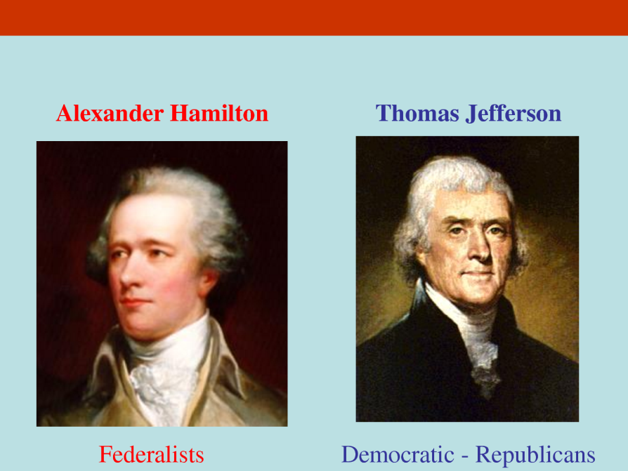
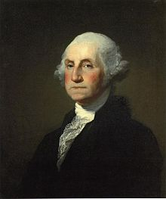
Inventing America
How did Hamilton and Jefferson differ in their views of the Constitution and the role of government?
Farewell Address
What does Washington say are the many ‘baneful effects’ of political parties?
What event was Washington thinking of when he warned about ‘foreign influence’?

Slide 44
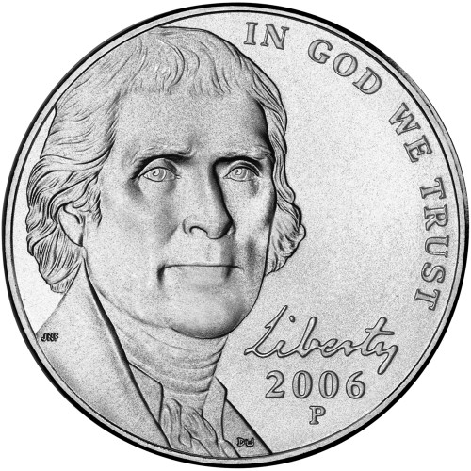
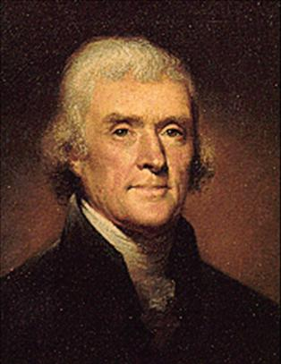
The Nation Expands
The Age of Jefferson
Jefferson’s Political Beliefs
farm ownership was the basis for a successful American society (An Agrarian society)
Problem = Population doubling every 25 yrs. & need twice as much land every generation
Louisiana Territory
1801 Napoleon forced Spain to give him the Louisiana Territory
Napoleon needs money to fight the British
1803 Jefferson paid $15 million & doubles the size of the US
Was this Constitutional?

Slide 45
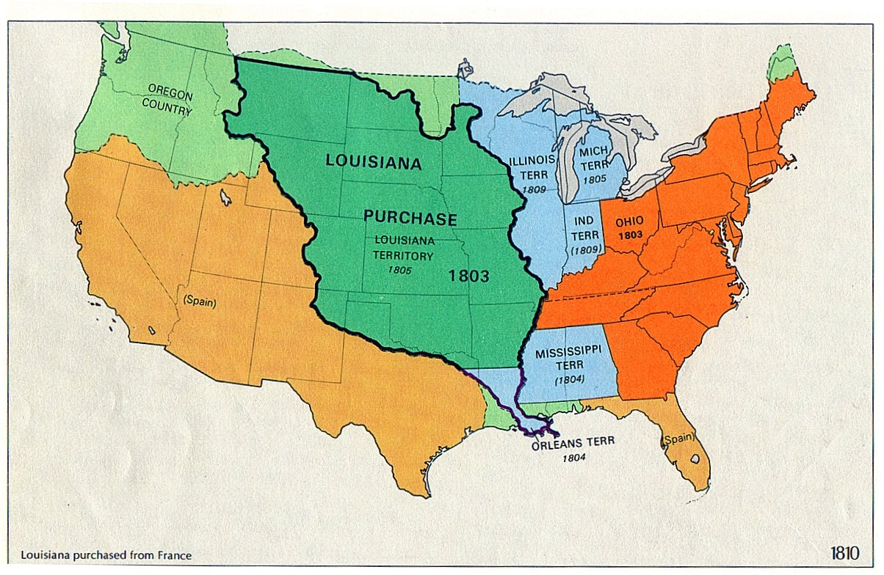
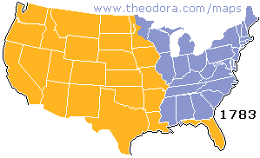

Slide 46
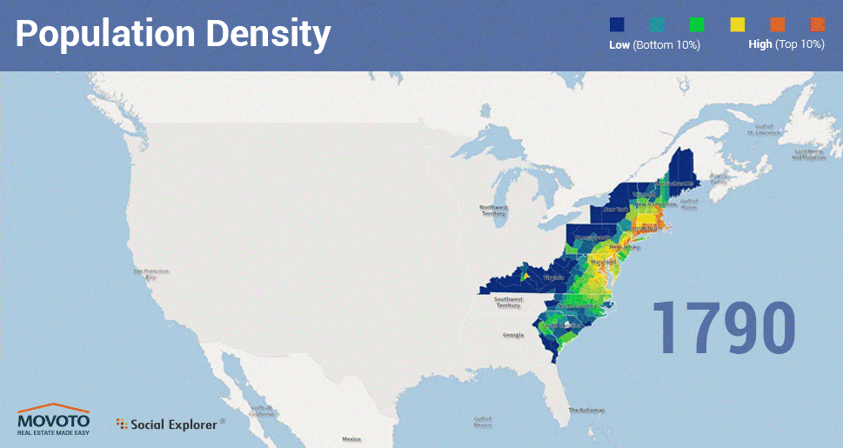

Slide 47
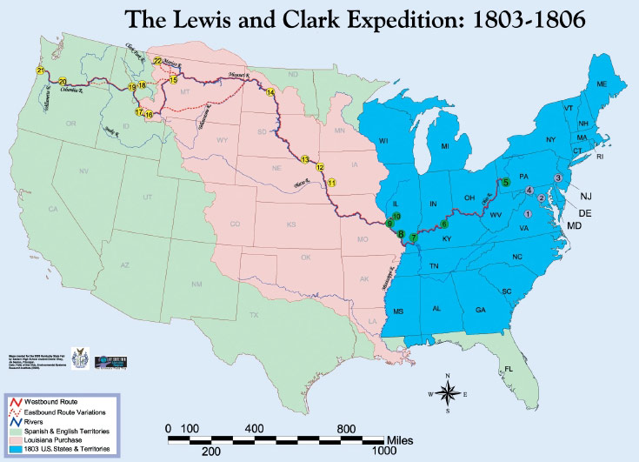
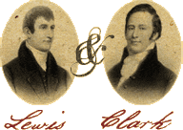
The Nation Expands
1804 - Lewis and Clark expedition explore new territory
Aided by Sacajawea & her husband

Slide 48
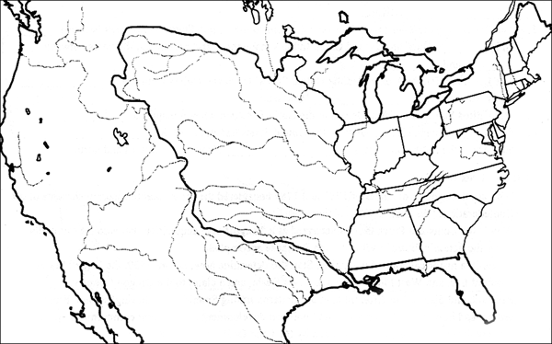
Analyze the Expansion of the United States

Slide 49
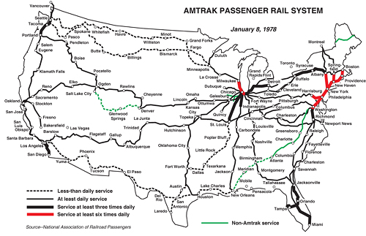
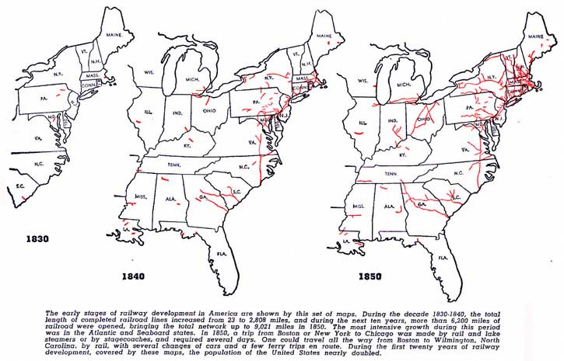

Slide 50
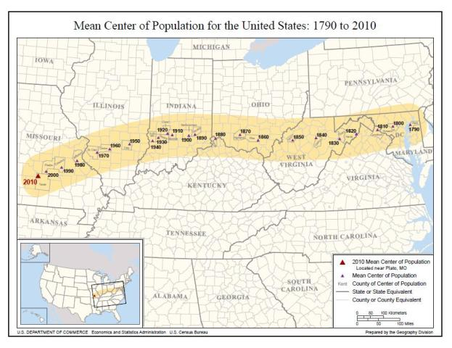

Slide 51
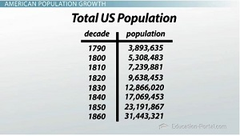
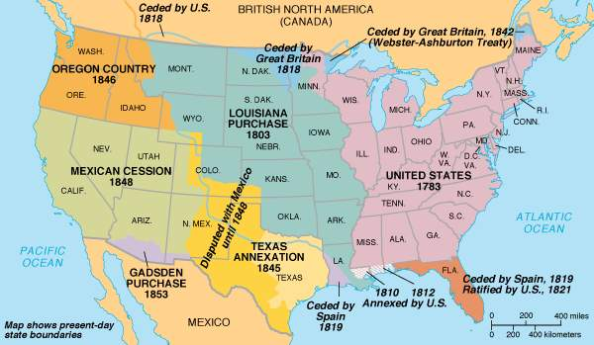
Key Concepts on Western Expansion
Americans believed the land in the west Belonged to them (“God Given,” not just purchased) and did not consider anyone else to be living on the land
Native Americans aren’t ‘using’ it in a traditional European sense
East Coast is too crowded
Doubling of population
West promises
Free land
Adventure
Opportunity
Wealth
50 years!
Over 1,125 Million Acres!!!

Slide 52
The War of 1812 Q: Why did the United States of America go to war with Britain and what was its outcome?
Causes
British Interfere with American Shipping
British interfere with American Expansion into western frontier
Southerners want Florida, which is owned by Britain's ally Spain
American ‘War Hawks’ want to expel Britain from North American completely
War
US invades Canada… Fails
1814-British march on Washington D.C., sack the city, and burned down the White House.
1814-British Arrive in larger Numbers - American troops defend better than they invade.
Slowly American forces defeat the British across the country.

Slide 53
The War of 1812 Q: Why did the United States of America go to war with Britain and what was its outcome?
Impact of the War
Long Term Impacts
The Treaty of Ghent ends the war (Dec 24th, 1814)
which does not address any of the causes of the war… but
2 weeks later Andrew Jackson wins the Battle of New Orleans (Jan 18th, 1815)
Creates the illusion that Jackson had forced the British into the treaty
Andrew Jackson won the War!
Growth of American Nationalism
The nation is free to grow and expand into western territory (and into the newly acquired Spanish Florida.)

Slide 54
Growth of Nationalism
Review
The Louisiana Purchase grows the expanse of the US
The War of 1812 helps to create a nationalistic spirit and opens the way for westward expansion
Nationalism = patriotic feeling, principles or efforts. Pride in one’s country
*expanding western ward becomes a nationalistic endeavor
*Andrew Jackson comes to represent the Nationalistic spirt at this time

Slide 55
Nationalism How did domestic and foreign policies reflect the nationalism of the early 1800's?
Domestic Policies
Foreign Policies
American System (by Hamilton)
National Bank to encourage commerce
Tariffs to protect & strengthen American industry
Federal subsidies for roads, canals and other ‘internal improvements’
More power to the Supreme Court
Expansion into Florida
The Monroe Doctrine 1823
***Further Efforts by European nations to colonize land or interfere in the Americas would be viewed as an act of aggression, requiring US intervention
All colonies of Spain & Portugal had become independent
Supported by many Presidents

Slide 56
The American Dream
What do you think the American Dream is?

Slide 57
American Exceptionalism
Define
Impact
The belief that America was special, and had an obligation to grow and prosper.
Supported by the idea that America was ‘different’ from other nations b/c
‘first new nation’
American ideology (egalitarianism, republicanism, individualism…)
“City upon a Hill” that sets an example for all other countries
Mixed Results:
This served the interests of the ruling elite while working to establish America as a factor beyond its borders.

Slide 58
Is America Exceptional? Two views
Two Views
Where did this idea come from?
Benefits | Drawbacks
The theory of exceptionalism can be traced to Alexis de Tocqueville, the first writer to describe the United States as "exceptional" in 1831 and 1840.
US History Standard 11: Understands the extension, restriction and reorganization of political democracy after 1800.

Slide 59
Is America Exceptional? Two views
Benefits
Drawbacks
Americans have long embraced a notion of superiority, claims Howard Zinn. Governor Winthrop of the Massachusetts Bay Colony described establishing "a city on a hill," to serve the world as a beacon of liberty. So far, so good. But driving this sense of destiny, says Zinn, was an assumption of divine agency "an association between what the government does and what God approves of." And too frequently, continues Zinn, Americans have invoked God to expand "into someone else's territory, occupying and dealing harshly with people who resist occupation." Zinn offers numerous examples of how the American government has used "divine ordination" and rationales of spreading civilization and freedom to justify its most dastardly actions:
the extermination of Native Americans and takeover of their land; the annexation of Texas and war with Mexico; war against the Philippines; U.S. involvement in coups in Latin America; bloody efforts to expand U.S. influence in the Middle East, Africa and Asia. The battle against Communism, often bolstered by arguments of America's divine mission in the world, was merely a convenient excuse to maintain U.S. economic and military interests in key regions.
There is no denying it: America is the greatest country in the world. We are blessed with unparalleled freedoms and boundless prosperity that for generations have inspired an innovative and industrious people. America is exceptional.
American Exceptionalism is the standard that our laws reflect the understanding that we are afforded certain God-given rights that can never be taken away. We know that are bestowed with these inalienable rights, and because of that, they must not be compromised by the whims of man. This makes us a unique nation, a nation that remains, as President Ronald Reagan once said, "a model and hope to the world."

Slide 60
How is American Exceptionalism connected to the idea of an ‘American Dream’?
Quick Write
Is the American Dream unique to America?
Do you think other nations or cultures have aspirations similar to our own? (success, freedom, progress as a society…)
Are there other countries in history that have also viewed themselves as exceptional? (use an example)

Slide 61
Andrew Jackson
What changes did Andrew Jackson represent in American political life?
Andrew Jackson’s Presidency
“a mixed legacy”
Andrew Jackson was elected by popular vote;
sought to act as the direct representative of the common man
Democrats develop a new party structure
Government jobs given to members of the wining party (the Spoils System)
Indian Removal Act
Should Andrew Jackson be on the 20 dollar bill?

Slide 62
Big Block of Cheese Day
http://www.youtube.com/watch?v=Vm9HZq53rqU
By 1837 Jackson’s second term was winding down, So he decided to make the famed fromage a featured player at his last public reception at the White House. It was an astute move; there’s nothing people love more than free food. The reception’s 10,000 visitors attacked the wheel of cheese with such fervor that the entire thing was gone within two hours.
Dairy farmer Colonel Thomas S. Meacham of Sandy Creek, NY, sent Jackson a wheel of cheese that was four feet in diameter and two feet thick, weighed nearly 1400 pounds, and was wrapped in a giant belt that bore patriotic inscriptions like, “The Union, it must be Preserved.”

Slide 63
Constitutional Disputes Emerge Nullification = The idea that a state could refuse to recognize or to enforce a federal law passed by the United States Congress if that state disagreed with it.
The Nullification Crisis began over tariff passed by Congress
South Carolina declared the tariff unconstitutional.
(They also blocked the collection of the tax at their seaports.)
Andrew Jackson came out against nullification
Willing to use force to maintain the union
John C. Calhoun supported nullification
Proposed seceding from the Union
End Result: A compromise tariff was passed and succession avoided
The state of South Carolina made an attempt in nullifying a federal law.
“Can a state refuse to enforce a federal law passed by the United States Congress?”

Slide 64
“Can a state refuse to enforce a federal law passed by the United States Congress?”
The Issue
Current Events Connection
The 10th amendment grants States all the powers not reserved by the Federal gov’t or prohibited the States…
Does this mean states can pass laws contradictory to Federal laws?
March 2010 – 4 states have passed laws that nullify federal regulation on commerce within state boundaries
Sanctuary Cities direct local police not to work with ICE or arrest anyone for being an illegal immigrant
National Health Care nullification – 30 states have proposed laws & 4 have passed laws that would nullify the national health care system
16 states have passed laws allowing the use of medical marijuana & as of 2012 2 states allow anyone 21 or older to posses an ounce for whatever purpose.
As of 2013 27 states proposed laws nullifying federal authority over local firearms
Pros & Cons of
Nullification?

Slide 65
Outbreak of War Timeline
Causes
Texans rebel against the gov’t in 1835
Declare independence in 1836
Mexico retaliates by attacking the Alamo
Generalissimo Santa Anna defeated… Surrenders Texas
Mexico does not honor the peace treaty – no agreement on border
Congress Annexes Texas in 1845
President James Polk sends Troops to the contested borderland
Border clash starts the Mexican-American War
Manifest Destiny: the belief that America is meant to spread west
Americans begin to settle in the Texas region
At 1st encouraged by Mexican gov’t… but on the condition they follow Mexican laws

Slide 66
Polk and Manifest Destiny
When should a country go to war?
Discussion Question
Was Manifest Destiny a new idea or merely a new term for a well established American pattern of expansion?

Slide 67
Effects of the War – Territory exchanged:
The Mexican territorial claims relinquished in the Treaty of Guadalupe Hidalgo in white.
Gadsden Purchase in brown

Slide 68
Mexican American War What were the effects of the Mexican American War?
Effects
Discussion
The Treaty of Guadeloupe Hidalgo, US gains territory (but will it be slave or free?)
Rio grade is the new southern border of Texas
Wilmot Proviso
Would have banned slavery in any area gained from the war…failed to pass
Mexican-Americans stripped of land and rights
Native Americans terrorized and killed
California Gold rush led to debate over slavery
California finds gold→ population boom → apply for statehood → debate over slavery
Can it be said the effects of the war put America on a disastrous path to war?

Slide 69
Manifest Destiny
How has the idea of Manifest Destiny shaped the American character?

Slide 71
Sectional Differences Develop How did the North and the South differ during the 1800's?
North
South
Industrialized Quickly
Cities grew
Middle Class was created
Wave of immigrants arrive
Mainly Agricultural
Cities stayed small
Slow population Growth
Education system was poor quality
Both
*Relied on cotton
*Benefited from new technologies

Slide 73
Sum it all Up
The Establishment of America and an American Identity
The Expansion of America and the conflicts that this causes
The American Revolution
Causes
Effects
The Constitution
Articles of Confederation
Weaknesses
Constitutional Convention
Proposals and Compromises
Debate over the Constitution
Federalists vs. Anti-Federalists
Constitutional Principles
Structure of Government
Individual Rights
The Nation Expands
Lewis and Clark
War of 1812
Age of Jackson
Trail of Tears
Nullification
Mexican American War
Justification
Impact
Wilmot Proviso
Sectionalism

Slide 74
Assessment of American Democracy
Activity
Grading America
Read “A foreigner’s Assessment of American Democracy”
Grade Americans for their progress toward equality from the writing of the Declaration of Independence to the end of the Jacksonian era.
Read Harriet Martineau’s evolution of American Democracy in the 1830s and write a short paragraph summarizing her main idea.
Political Equality
Economic Equality
Social Equality
Religious Freedom

Slide 76
http://www.geocurrents.info/geopolitics/mapping-forms-of-government-in-the-18th-century-and-today

