Slide 1
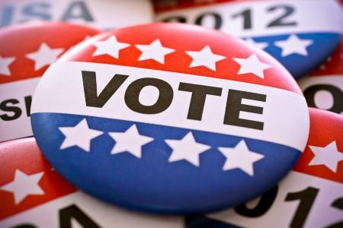
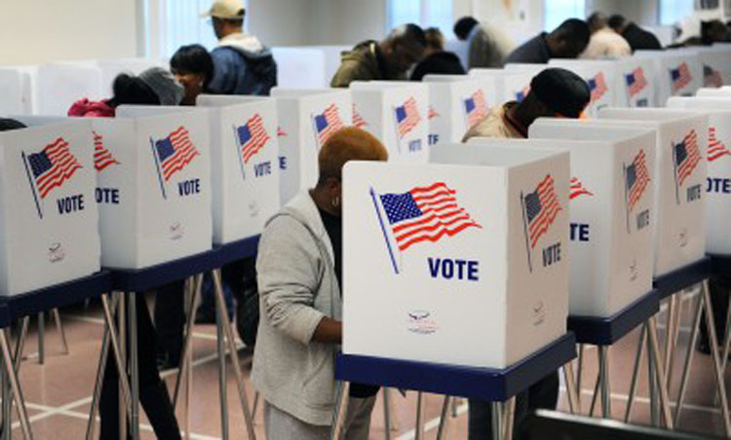
Voter Participation
Should Voting be Required in the United States?

Slide 2
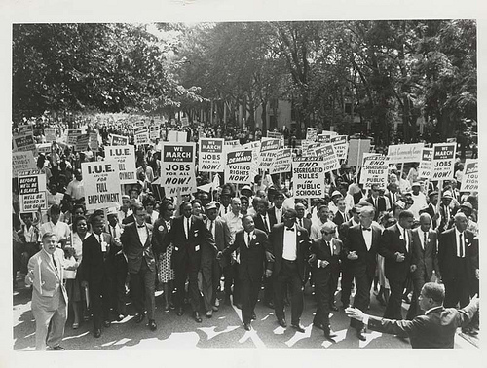
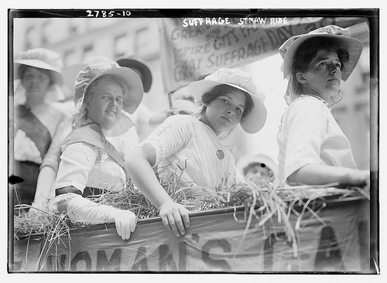
Voting History Facts
14th Amendment (1868) Males/21 yrs old
15th Amendment (1870) Eliminated Race Base Qualification to Vote
17th Amendment (1913) Elect US Senators by popular vote after they had previously been elected by the State Legislatures
19th Amendment (1920) Extended Voting Rights to Females
24th Amendment (1964) Poll taxes prohibited
26th Amendment (1971) Age reduced to 18
Notes:
The Fourteenth Amendment to the United States Constitution (Amendment XIV) is one of the post-Civil War amendments (known as the Reconstruction Amendments), first intended to secure rights for former slaves. It includes the Due Process and Equal Protection Clauses among others. It was proposed on June 13, 1866, and ratified on July 9, 1868.[1] It is perhaps the most significant structural change to the Constitution since the passage of the United States Bill of Rights. The amendment provides a broad definition of United States citizenship, overturning the Dred Scott case, which excluded African Americans. It requires the states to provide equal protection under the law to all persons (not only to citizens) within their jurisdictions, and was used in the mid-20th century to dismantle legal segregation, as in Brown v. Board of Education. Its Due Process Clause has driven much important and controversial case law regarding privacy rights, abortion (see Roe v. Wade), and The
Fifteenth Amendment (Amendment XV) of the United States Constitution provides that no government in the United States may prevent a citizen from voting based on that citizen's race[1], color, or previous condition of servitude (i.e. slavery).
The Seventeenth Amendment (Amendment XVII) of the United States Constitution was passed by the Senate on June 12, 1911 and by the House on May 13, 1912. It was ratified on April 8, 1913 and was first put into effect for the election of 1914. It amends Article I, Section 3 of the Constitution to provide for the direct election of Senators by the people of a state rather than their election or appointment by a state legislature. Also, it allows the governor or executive authority of each state, if authorized by that state's legislature, to appoint a senator in the event of an opening, until an election occurs. It was passed and ratified during the Progressive Era.
The Nineteenth Amendment (Amendment XIX) to the United States Constitution provides that neither any individual state of the United States or the federal government may deny a citizen the right to vote because of the citizen's sex
Twenty-fourth Amendment) of the United States Constitution prohibits both Congress and the states from conditioning the right to vote in federal elections on payment of a poll tax or other types of tax. The amendment was proposed by Congress to the states on August 29, 1962 and was ratified by the states on January 23, 1964.
The Twenty sixth Amendment (Amendment XXVI) of the United States Constitution, ratified on July 1, 1971, standardized the voting age to 18.

Slide 3
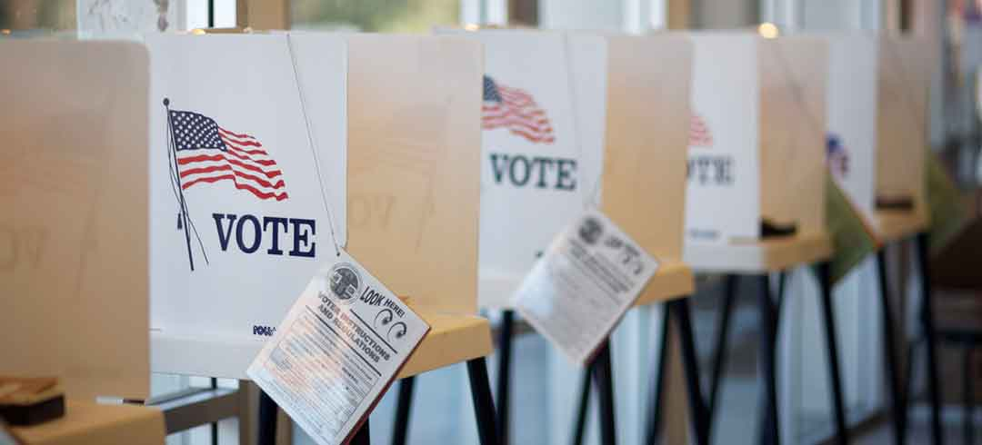
Voting Qualifications
In order to vote in U.S. elections you must be
18 years old
Resident of the state you’re voting in
Citizen of the U.S.
Registered to vote

Slide 4
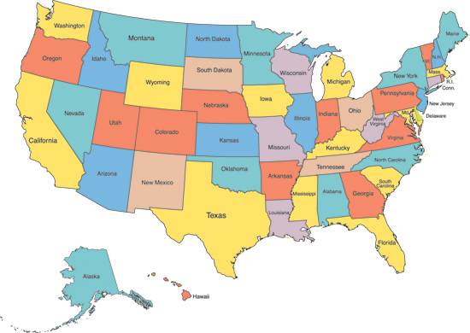
Basic Voting Information
Each State controls it’s own elections
You can vote in your state of legal residency
You can vote in all elections where your are eligible
You can only vote in one state
You cannot arbitrarily choose a state

Slide 5
When Do I Vote?
General Election Day
1st Tuesday after the 1st Monday in Nov.
Could be voting for
President of the U.S.
Governor
Senators
Representatives
State Legislators
Any state, federal, or local officials
Mid-term Elections (Same Day as Above)
Elections in which members of Congress and some Governors are being elected, but not the President
Every 4 Years
Every 2 Years
Local Elections vary from state to state - an election for a specific local office may be held at the same time as either the presidential, midterm, or off-year elections

Slide 6
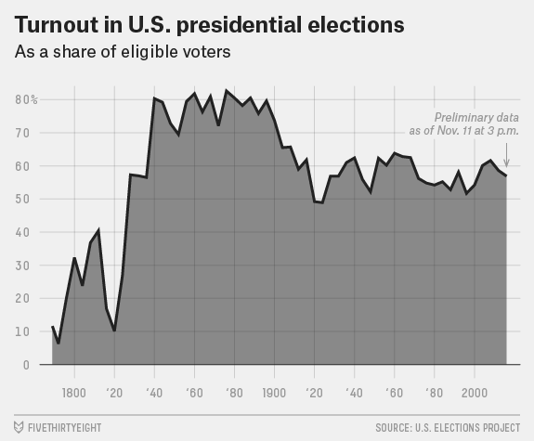
Voter Participation
Voter turnout in the United States fluctuates in national elections. In recent elections, about 60% of the voting eligible population votes during presidential election years, and about 40% votes during midterm elections. Turnout is lower for odd year, primary and local elections.
http://www.fairvote.org/voter_turnout#voter_turnout_101

Slide 7
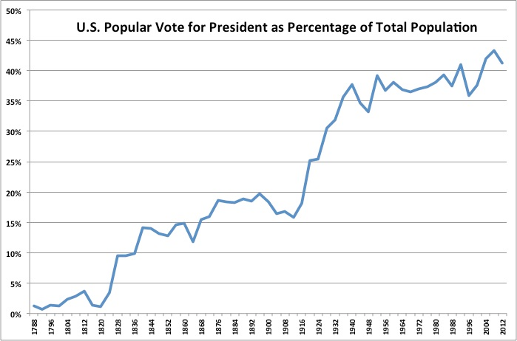
U.S. presidential election popular vote totals as a percentage of the total U.S. population.
Note the surge in 1828 (extension of suffrage to non-property-owning white men), the drop from 1890-1910 (when Southern states disenfranchised most African Americans and many poor whites), and another surge in 1920 (extension of suffrage to women).
Note also that this chart represents the number of votes cast as a percentage of total population, and does not compare either of those quantities with the percentage of the population that was eligible to vote.

Slide 8
Voter Turn-out by Age in USA
Several programs to increase the rates of voting among young people—such as MTV's "Rock the Vote" (founded in 1990) and the "Vote or Die" initiative (starting in 2012)—may have marginally increased turnouts of those between the ages of 18 and 25 to vote.
Recent decades have seen increasing concern over the fact that youth voting turnout is consistently lower than turnout among older generations.

Slide 9
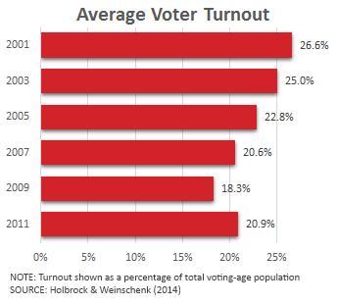
Local Elections
Voter turnout for local elections has historically lagged but is getting worse, prompting officials to explore new ways to get people to the polls.
http://www.governing.com/topics/politics/gov-voter-turnout-municipal-elections.html

Slide 10
Why Should I Vote?
The right to vote is considered to be our greatest freedom
Responsibility to society
People should exercise their right to vote because it allows citizens to
Choose their govt. leaders
Elect new leaders if dissatisfied with performance of current leaders
Express their opinions on public issues
What are some reasons people vote?

Slide 11
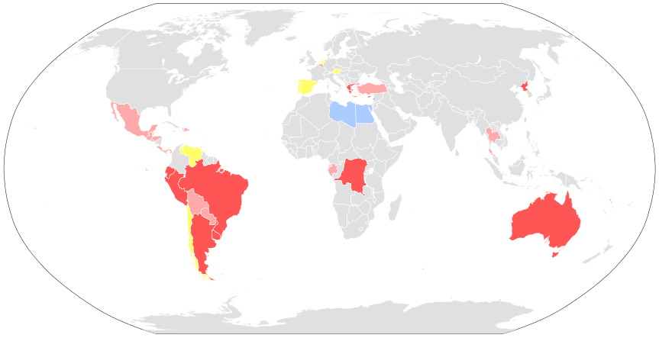
Compulsory voting is a system in which voters are obliged to vote in elections or attend a polling place on voting day.
If an eligible voter does not attend a polling place, or lodge a postal vote, he or she may be subject to a penalty such as fines or community service.
As of August 2013, 22 countries, including 12 Latin American countries, have laws for compulsory voting and 11 of these 22 countries enforce these laws in practice
Red - Compulsory voting, enforced. Pink - Compulsory voting, not enforced. Blue - Compulsory voting, enforced (only men). Teal - Compulsory voting, not enforced (only men). Yellow - Historical: the country had compulsory voting in the past

Slide 12
Essay # 2 – Voting in America
Steps to Writing a Persuasive essay
Understand the Question
Gather information (sources)
Brainstorm Argument for each side of the issue
Pick a side and write a thesis
Find supporting evidence from your sources
Organize your essay
Write!
Issue:
The State of Connecticut is looking into possible ways to increase voter turnout and are currently debating whether or not to enact legislation that would make voting compulsory (mandatory).

Slide 13
Essay # 2 – Voting in America
Steps to Writing a Persuasive essay
Understand the Question
Gather information (sources)
Brainstorm Argument for each side of the issue
Pick a side and write a thesis
Find supporting evidence from your sources
Organize your essay
Write!
Sources:
Background Essay
Statistics on Elections in the US
OP-Ed Excerpts
Political Cartoon
Chart
Video
Website

Slide 14
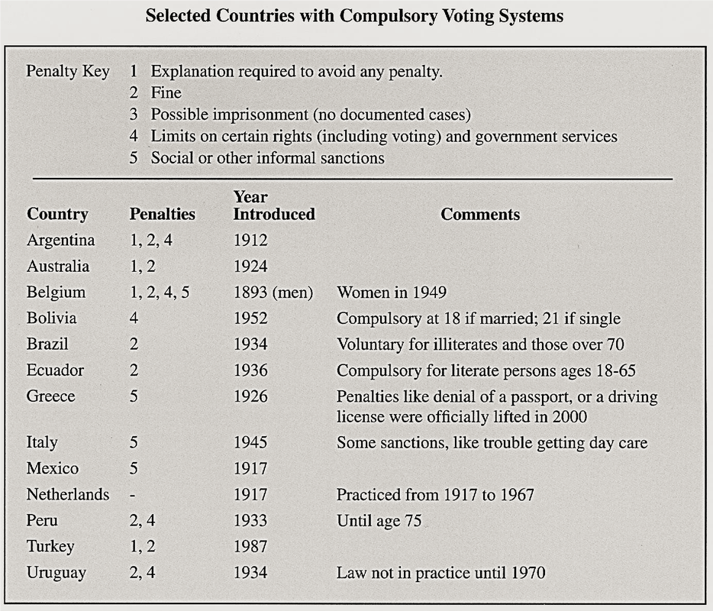
Analyzing Sources
1. What country has had compulsory voting the longest?
2. What are some of the possible consequences to someone who doesn’t vote in Peru?
3. How can this document be used to argue for requiring people to vote?
4. How can this document be used to argue against requiring people to vote?

Slide 15
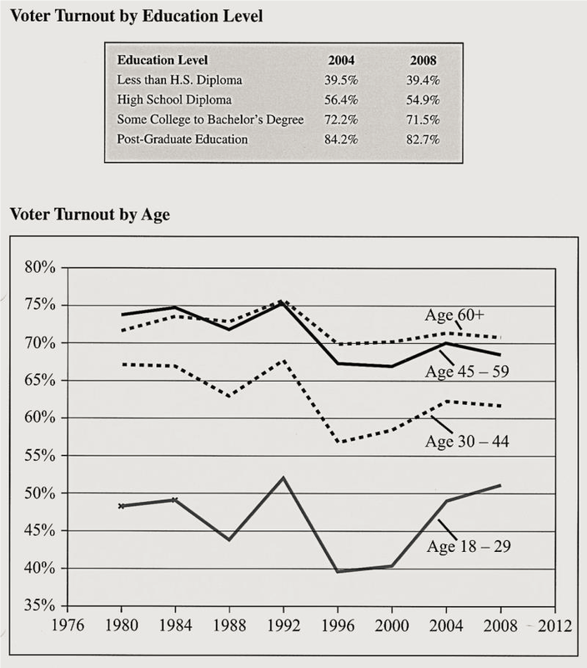
Analyzing Sources
1. In 2004, what was the difference in voter turnout percentage between people who had some college or a bachelor’s degree and people who did not have a high school diploma? What can you conclude about the relationship between how much education a person has and the likelihood that person will vote?
3. In 2004, what was the difference in voter turnout percentage between people ages 18-29 and people ages 60 and over?
4. What can you conclude about the relationship between a person’s age and the likelihood that person will vote?
5. How can you use this chart to argue for compulsory voting?
6. How can you use this chart to argue against compulsory voting?

Slide 16
Note Organizer
Should be Compulsory | Should NOT be Compulsory
Argument (Reason) 1: | Argument (Reason 1):
Argument (Reason 2) | Argument (Reason 2)

Slide 17
Introductory Paragraph
Background/ Introductory Sentence
Restate the Issue/ Topic
*Thesis
Thesis statement…
Position + Argument 1, Argument 2, Argument 3

Slide 18
Writing an Introduction
What an Introduction Should Accomplish
(1) it needs to address the audience or the specified reader
(2) it must introduce both the topic (background) and the issue to be addressed in the essay/letter
(3) it must smoothly flow into and conclude with the thesis statement
(1) Dear Congressman Courtney,
(2) Background
(2) Issue
(3) Thesis

Slide 19
Requirements
Use information from a minimum of 4 sources
Cite Source
How to cite sources:
(Document #1) or (Textbook pg. ____).
Take a position
You can include arguments from the opposing side BUT only if you can disprove them…
*Some Europeans may have killed Native Americans but other Europeans educated them in Europeans trades.
Organize your essay
Thesis statement…
Position + Argument 1, Argument 2, Argument 3
Paper organization should follow your Thesis

